Slide 1
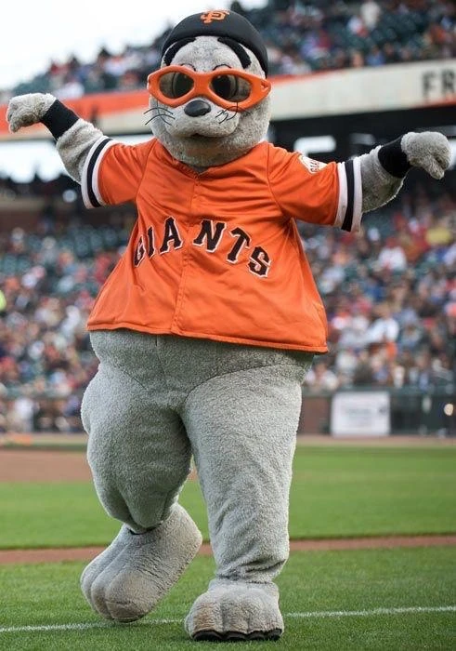
Notes:
Lou Seal

Slide 2
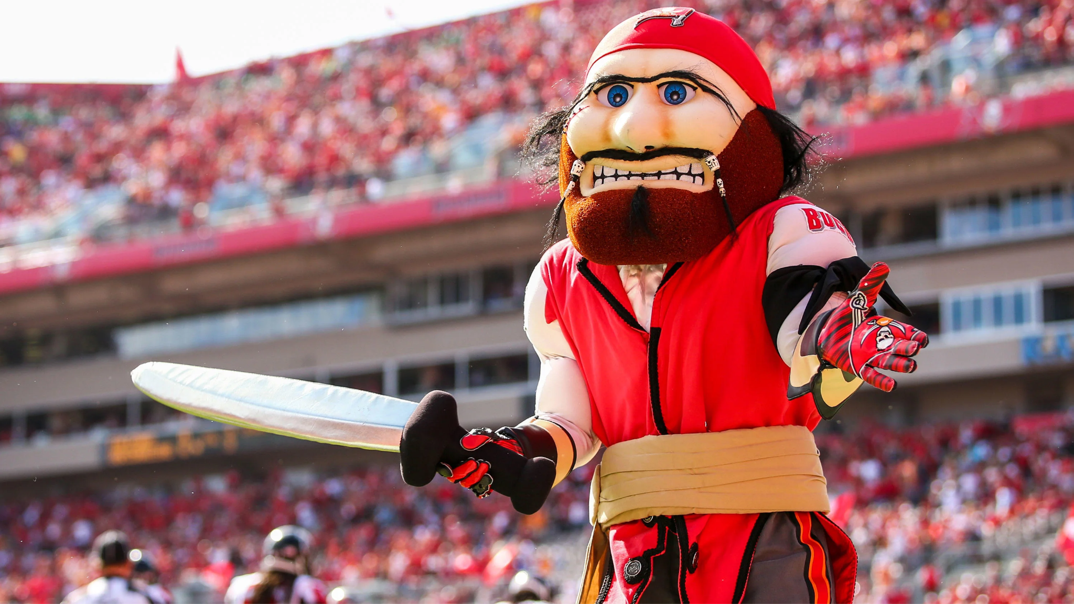
Notes:
Captain Fear - Tampa Bay Bucaneers

Slide 3
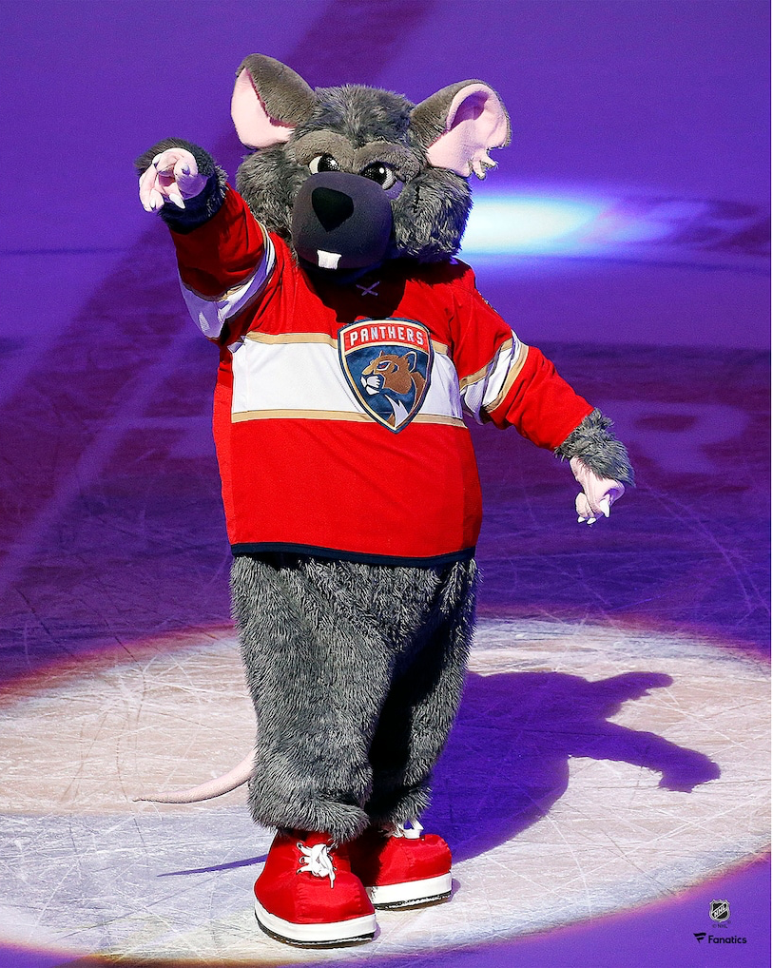
Notes:
Victor E Green

Slide 4
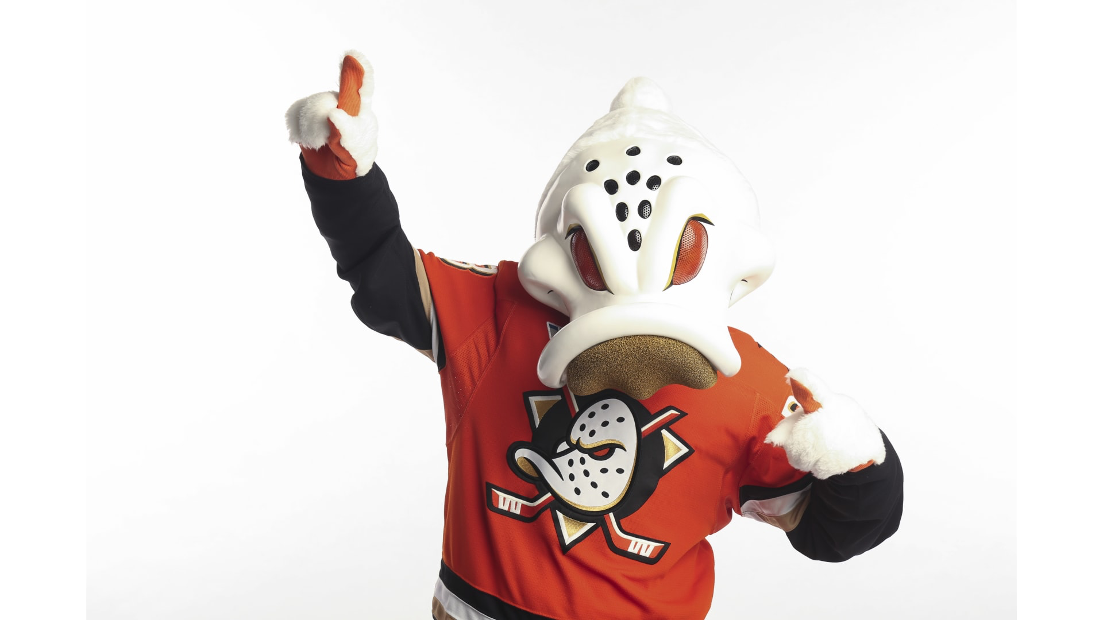
Notes:
Wild Wing

Slide 5
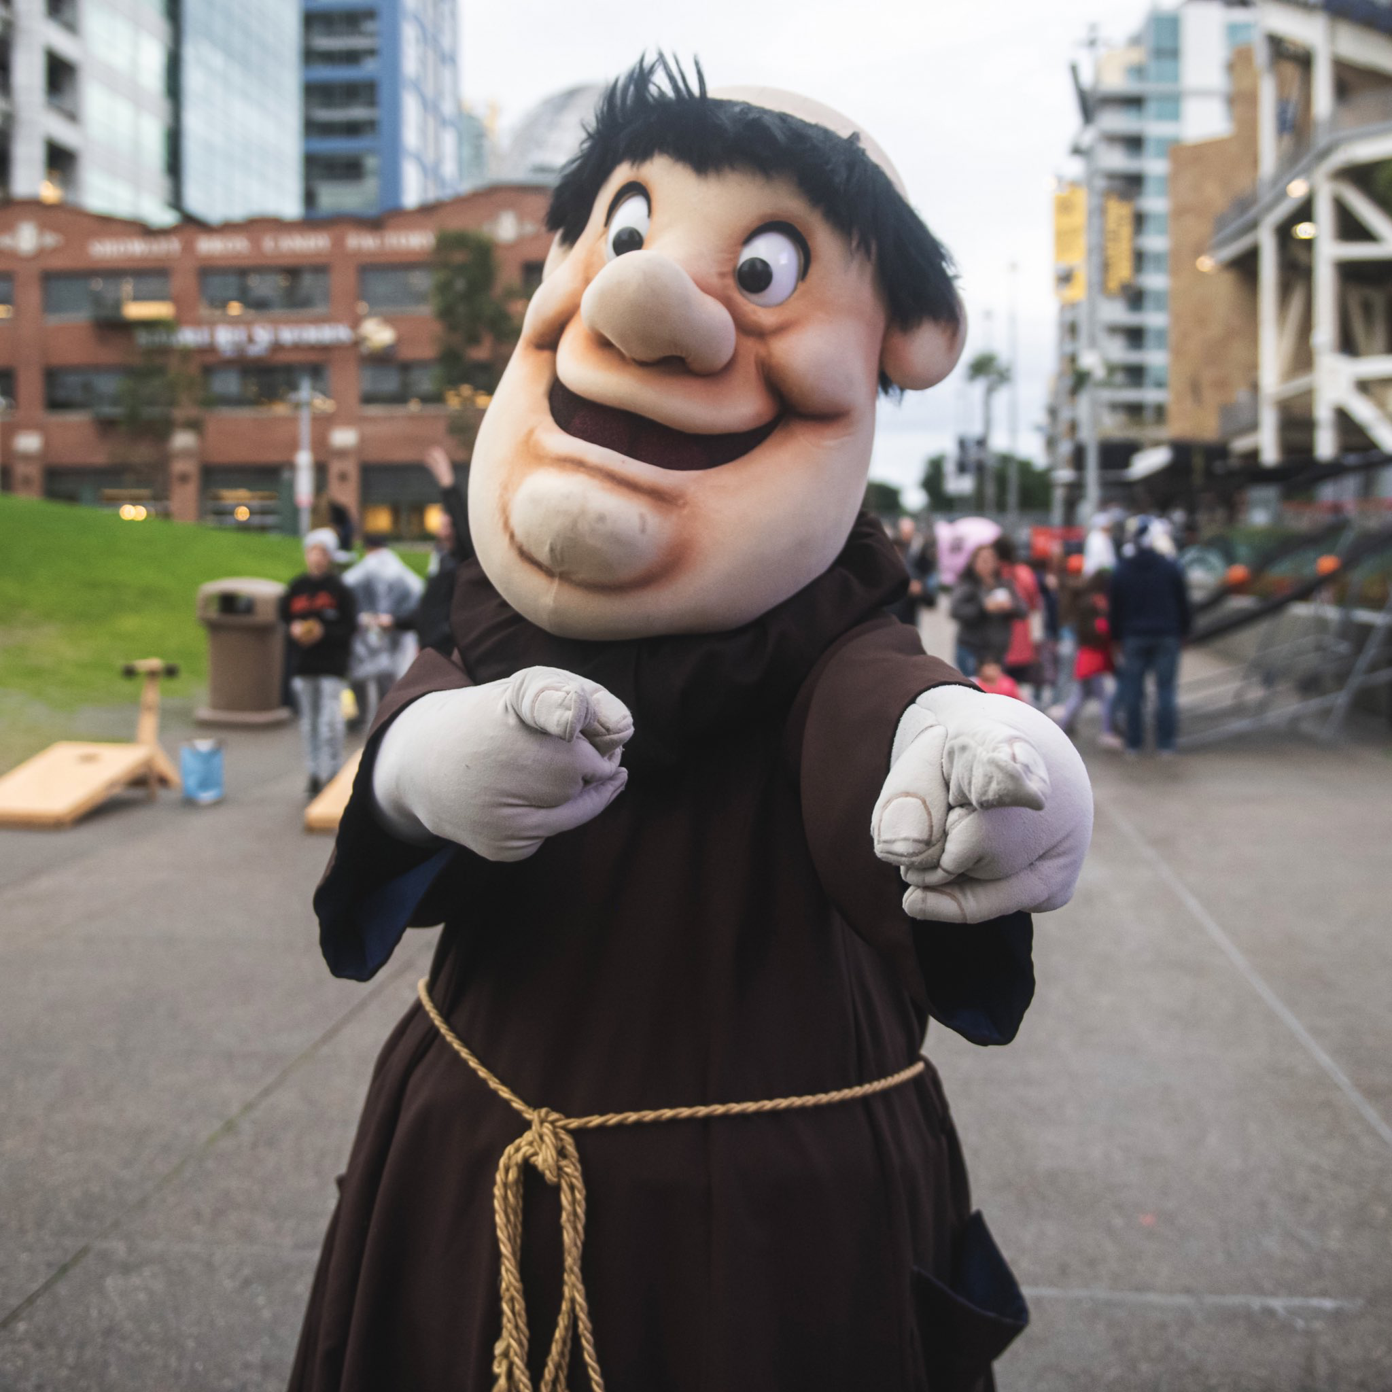
Notes:
Swinging Friar

Slide 6
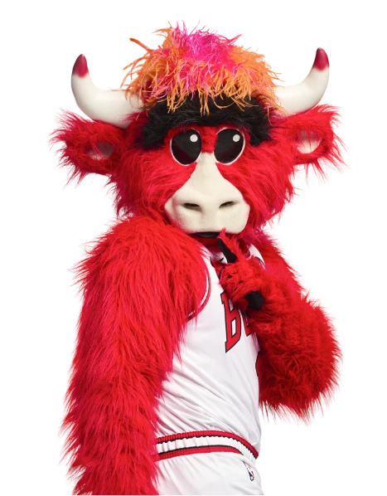
Notes:
Benny the Bull

Slide 7
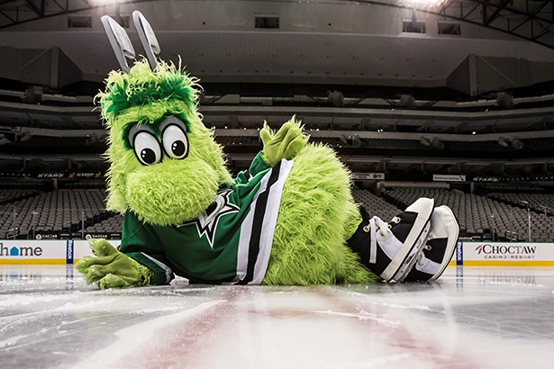
Notes:
Victor E Green

Slide 8
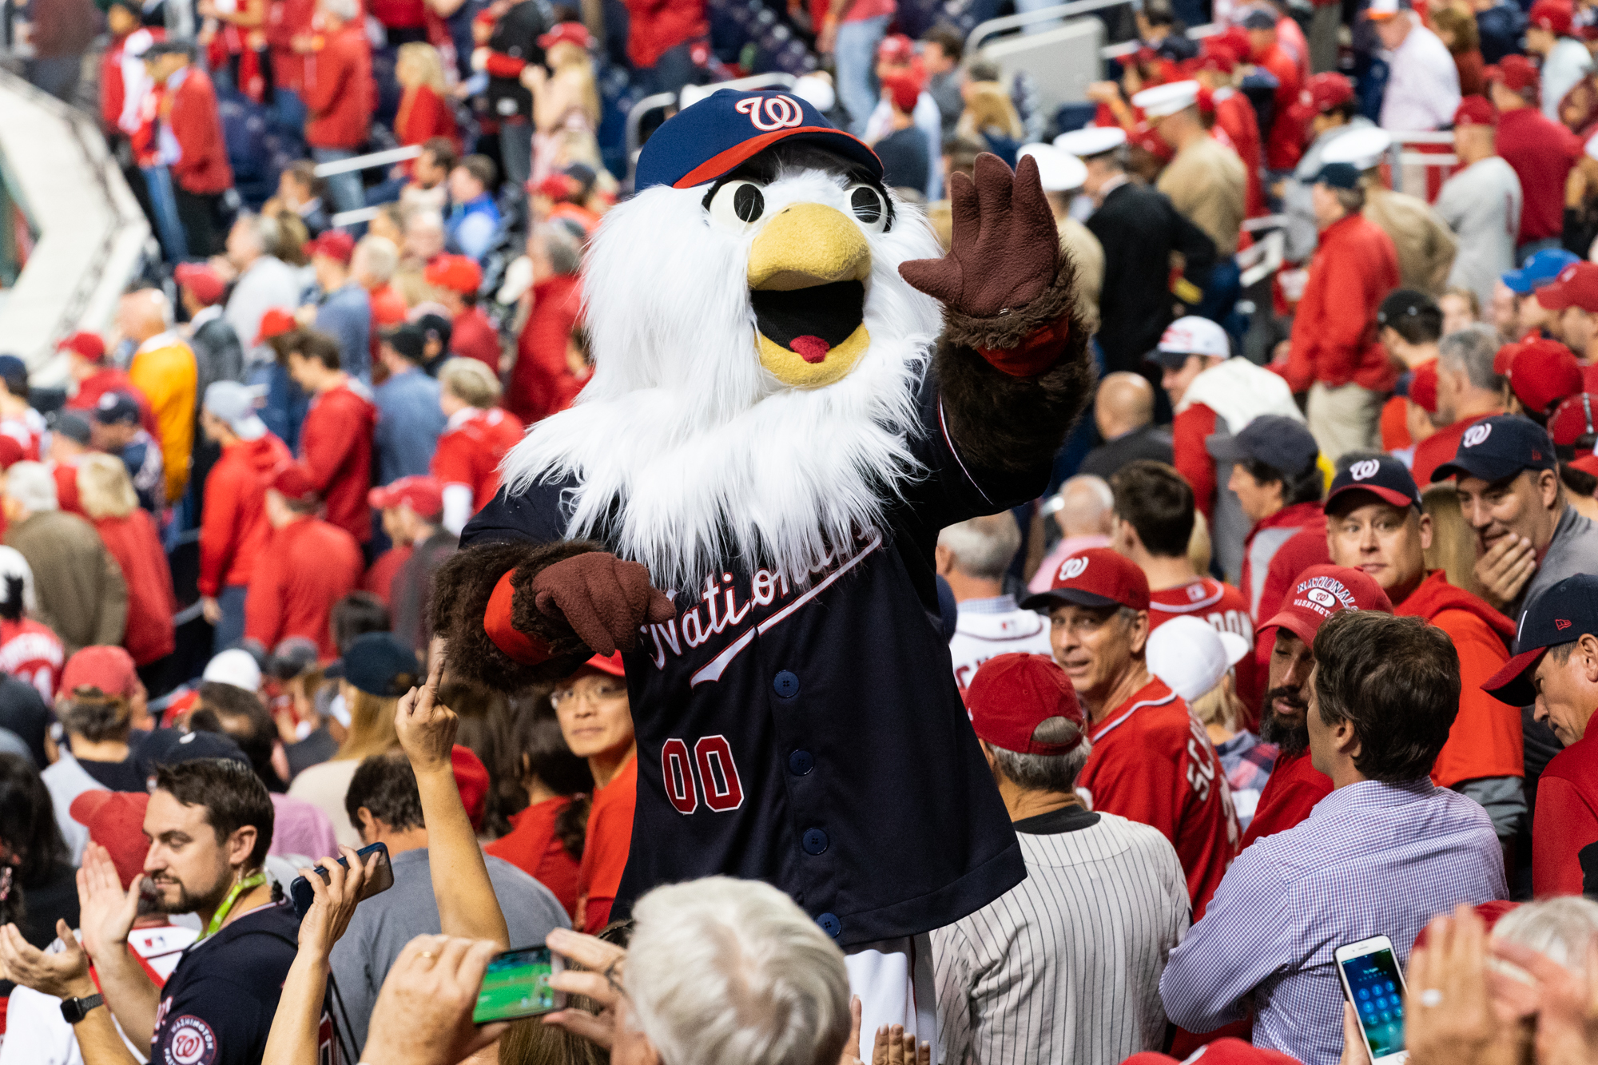
Notes:
Screech

Slide 9
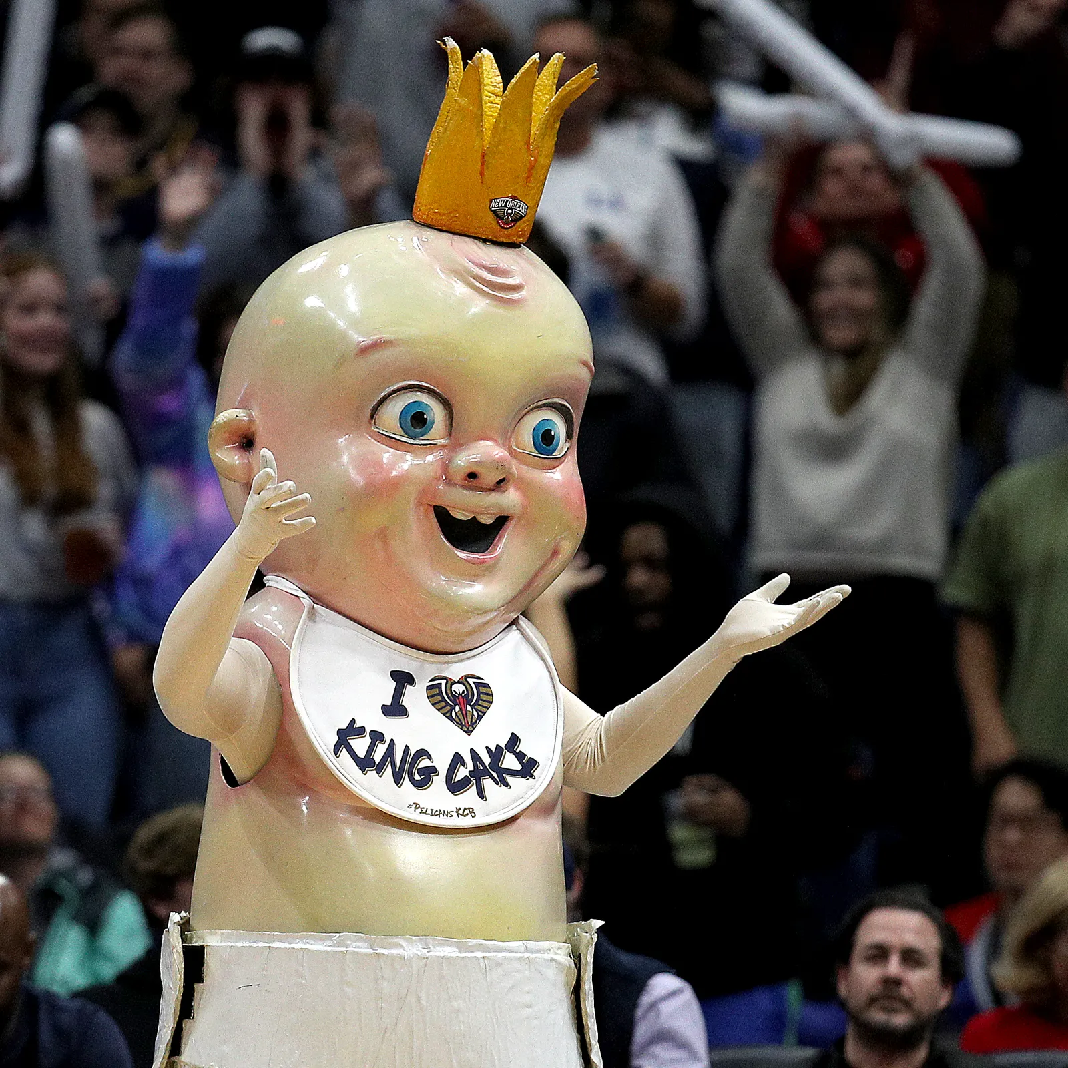
Notes:
King Cake Baby

Slide 10

Notes:
Spartacat

Slide 11
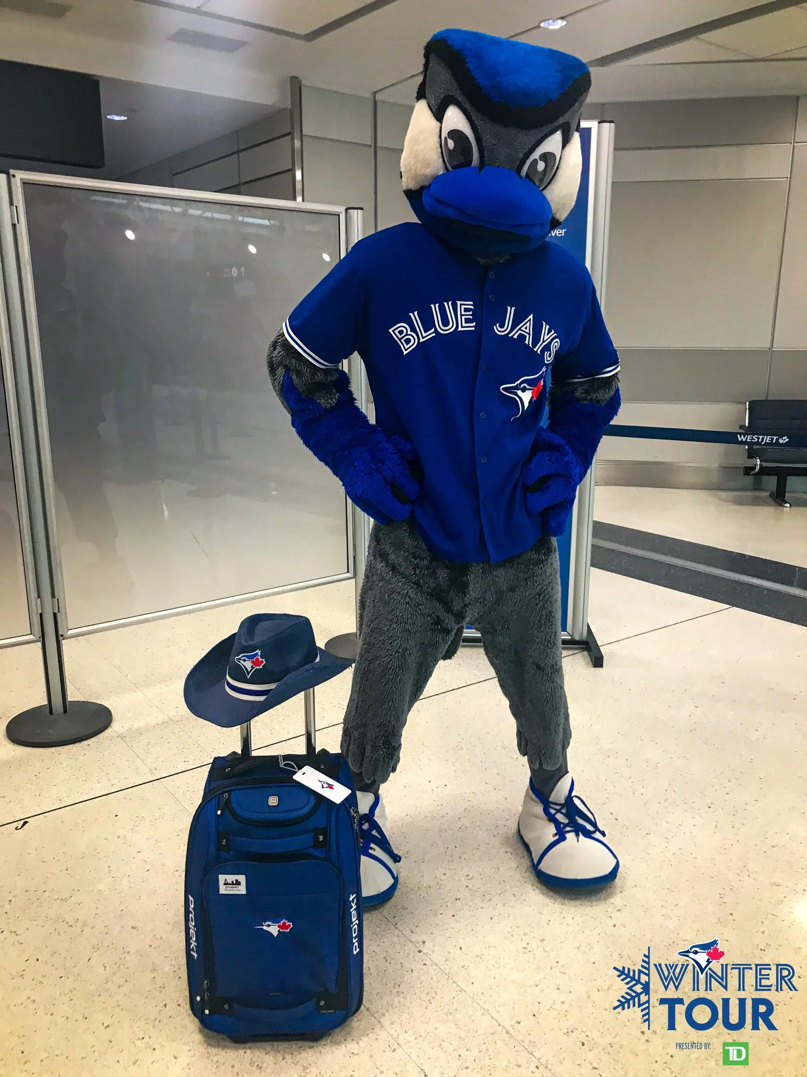
Notes:
Ace

Slide 12
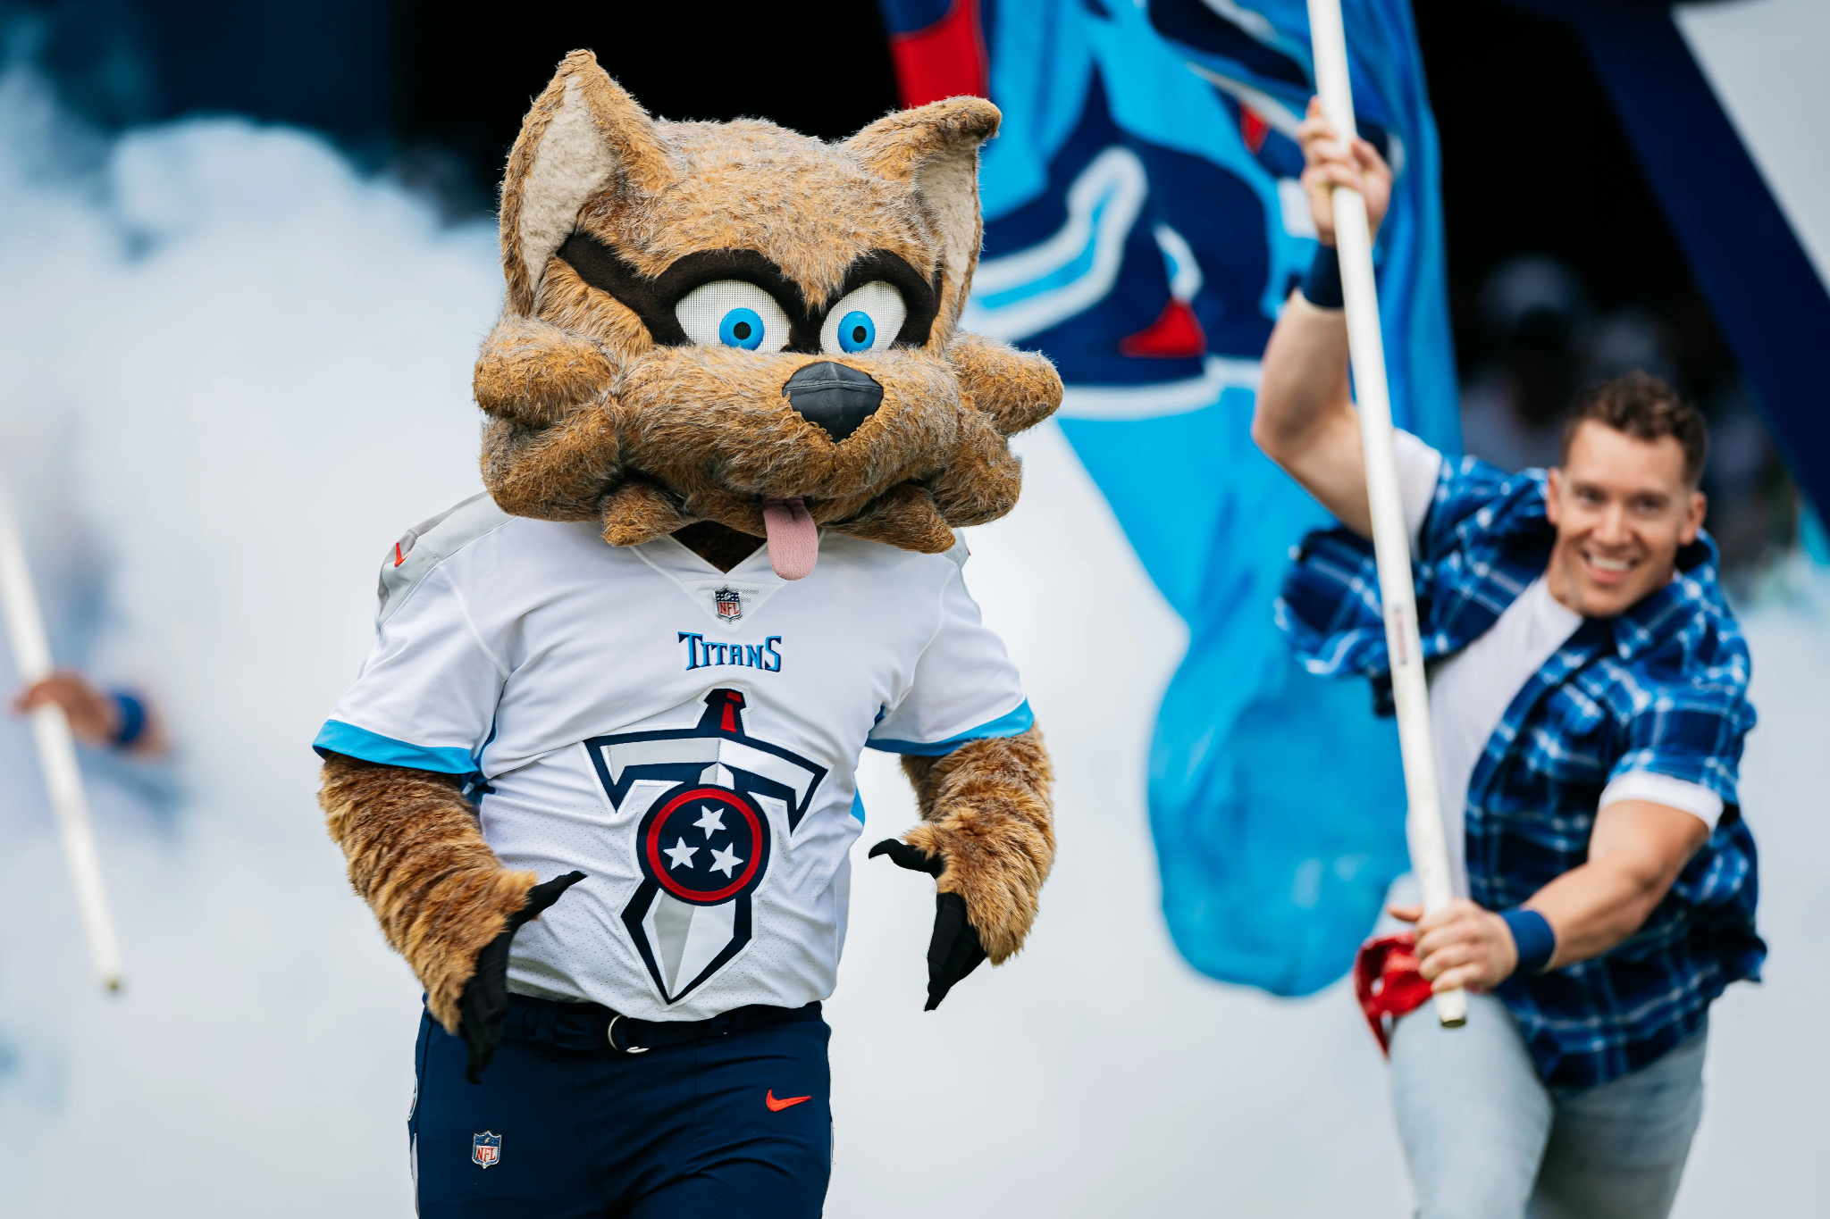
Notes:
T-rac - Tennessee Titans

Slide 13
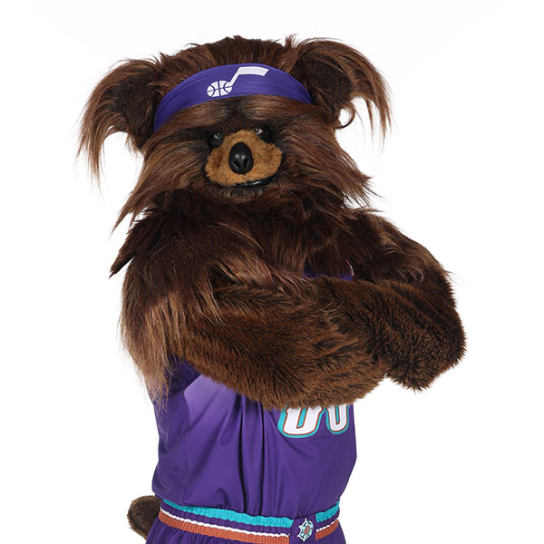
Notes:
Jazz Bear

Slide 14
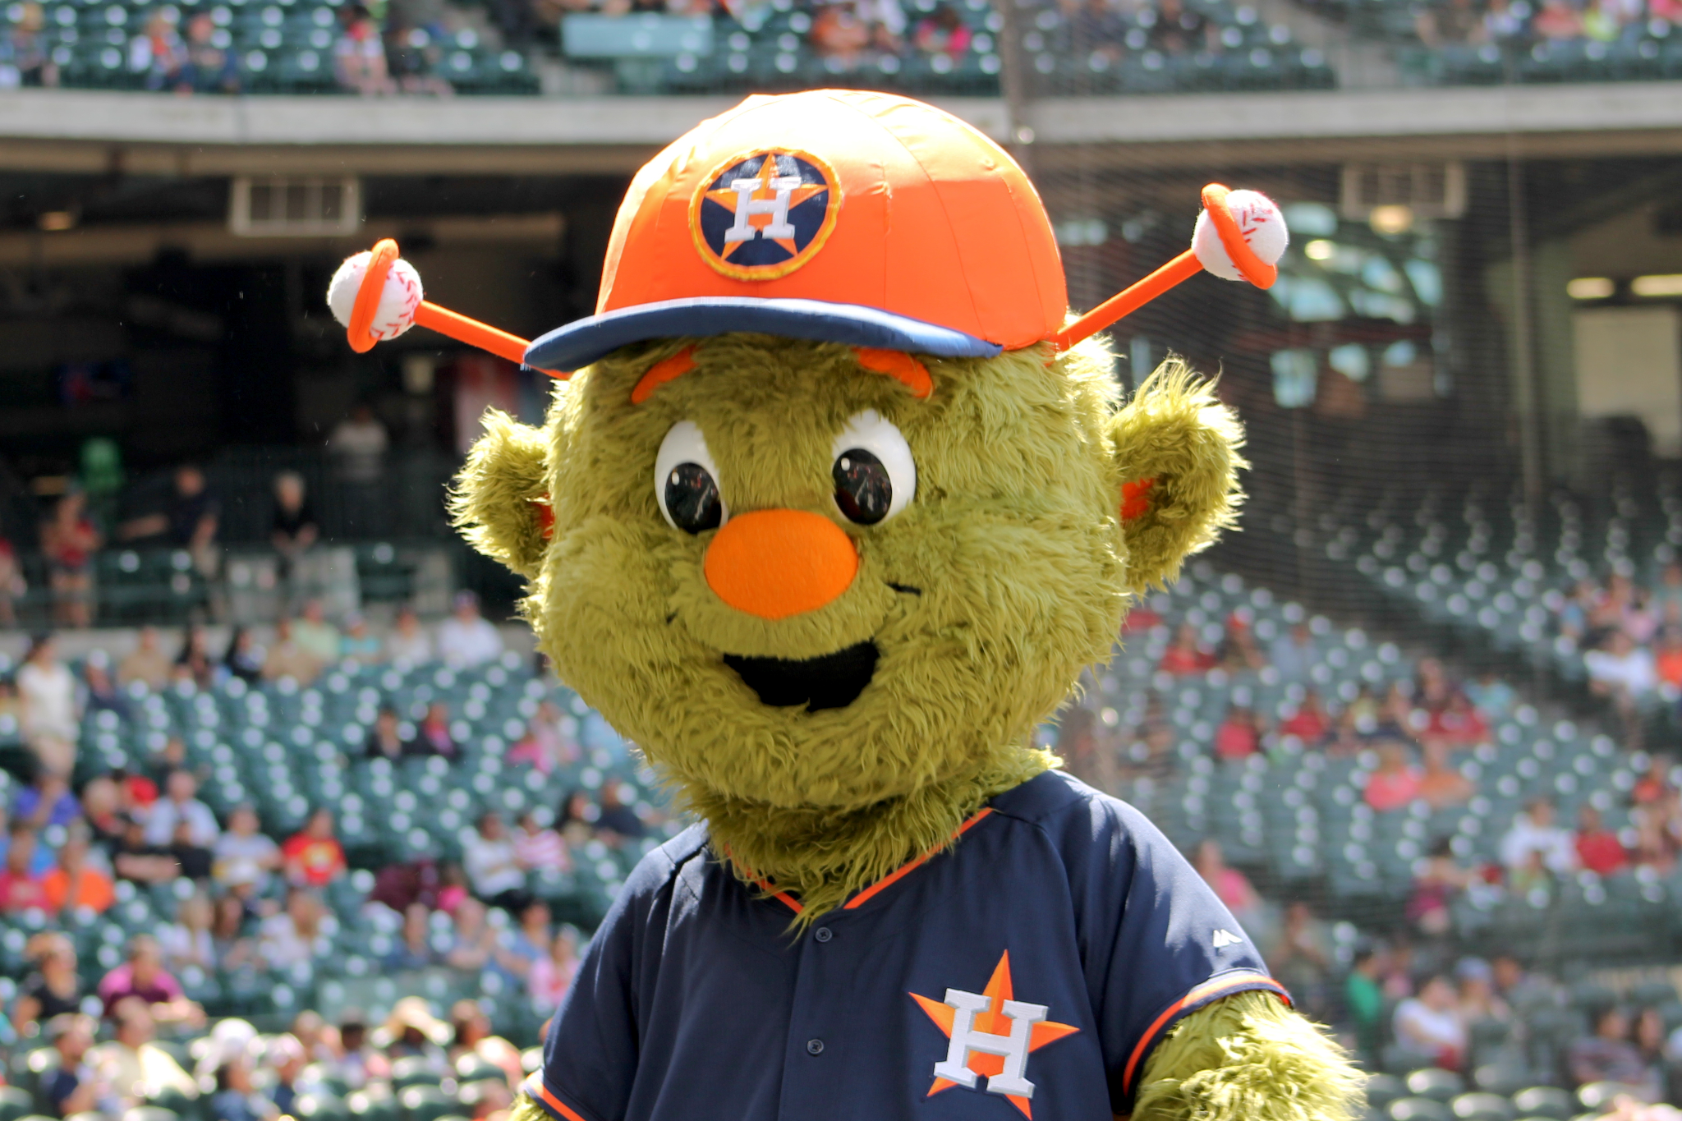
Notes:
Orbit

Slide 15
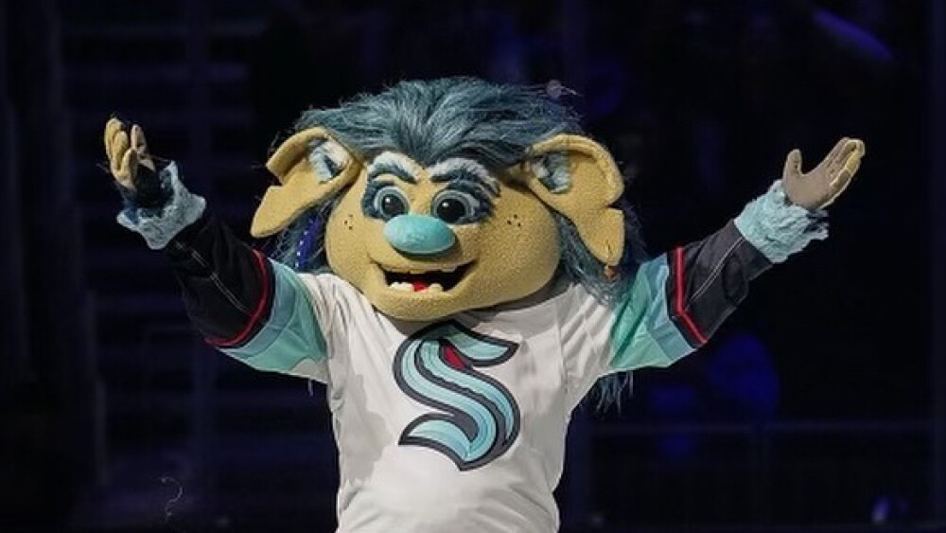
Notes:
Buoy

Slide 16
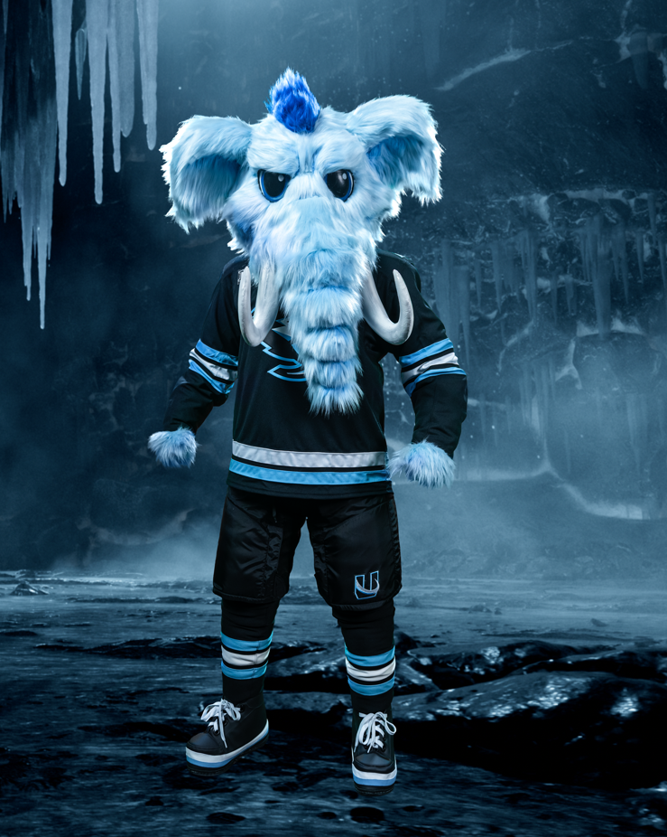
Notes:
Tusky

Slide 17
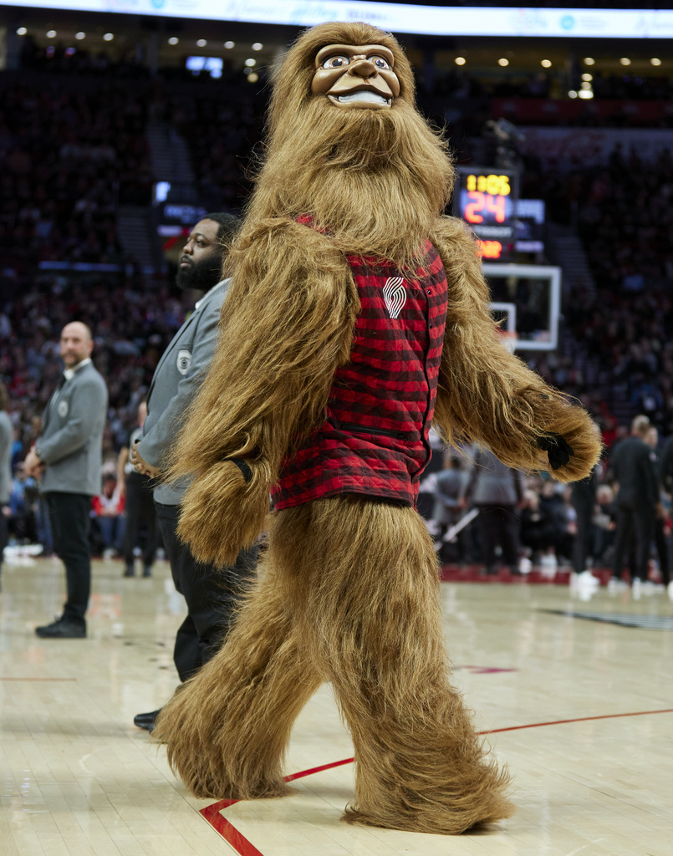
Notes:
Douglas Fur

Slide 18
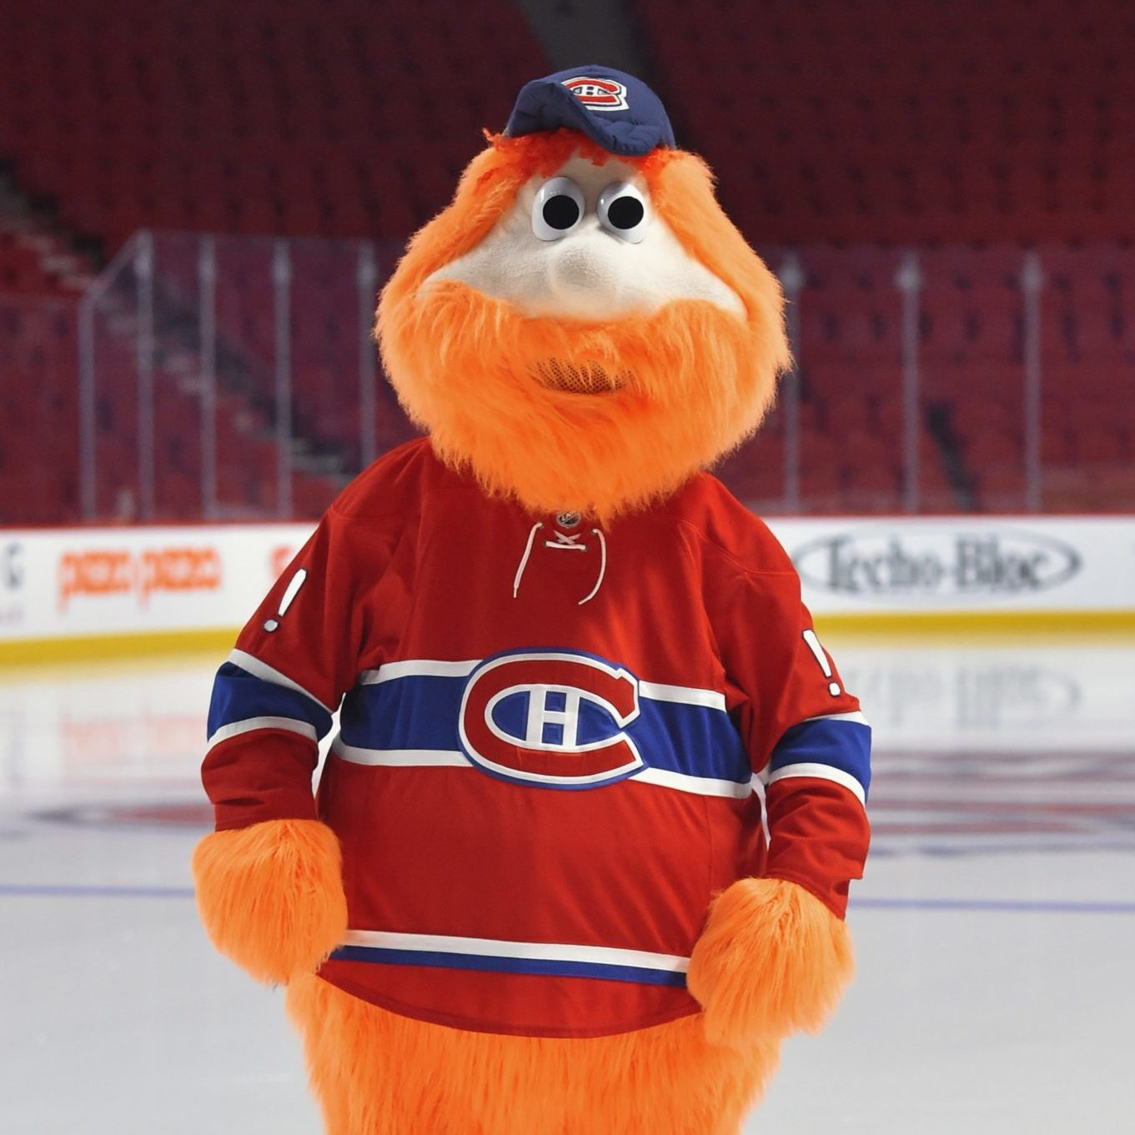
Notes:
Youppi

Slide 19
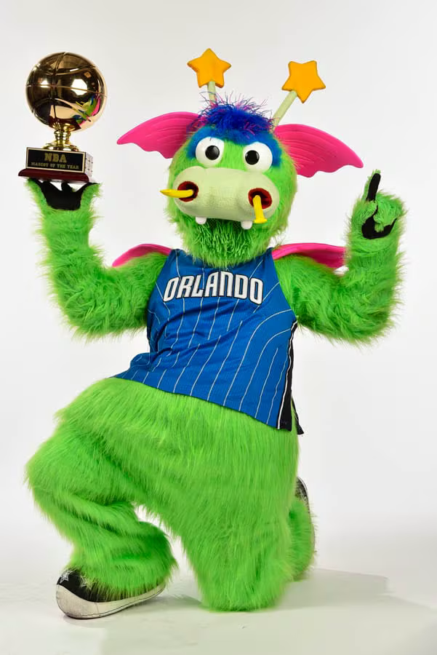
Notes:
Stuff the Magic Dragon

Slide 20
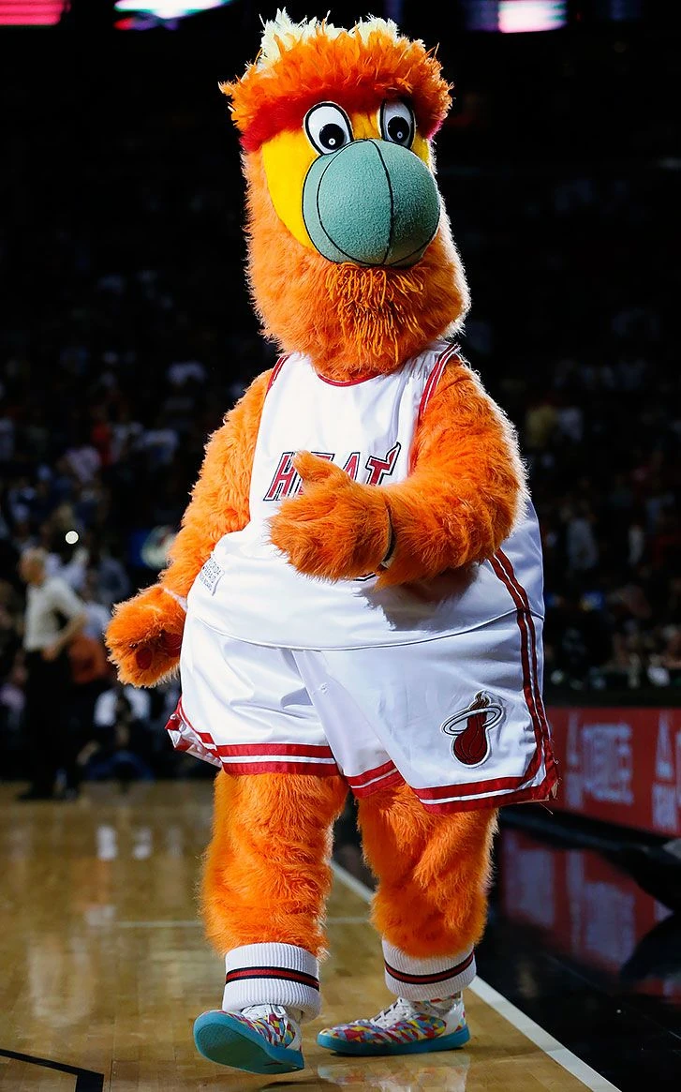
Notes:
Burnie Miami Heat

Slide 21
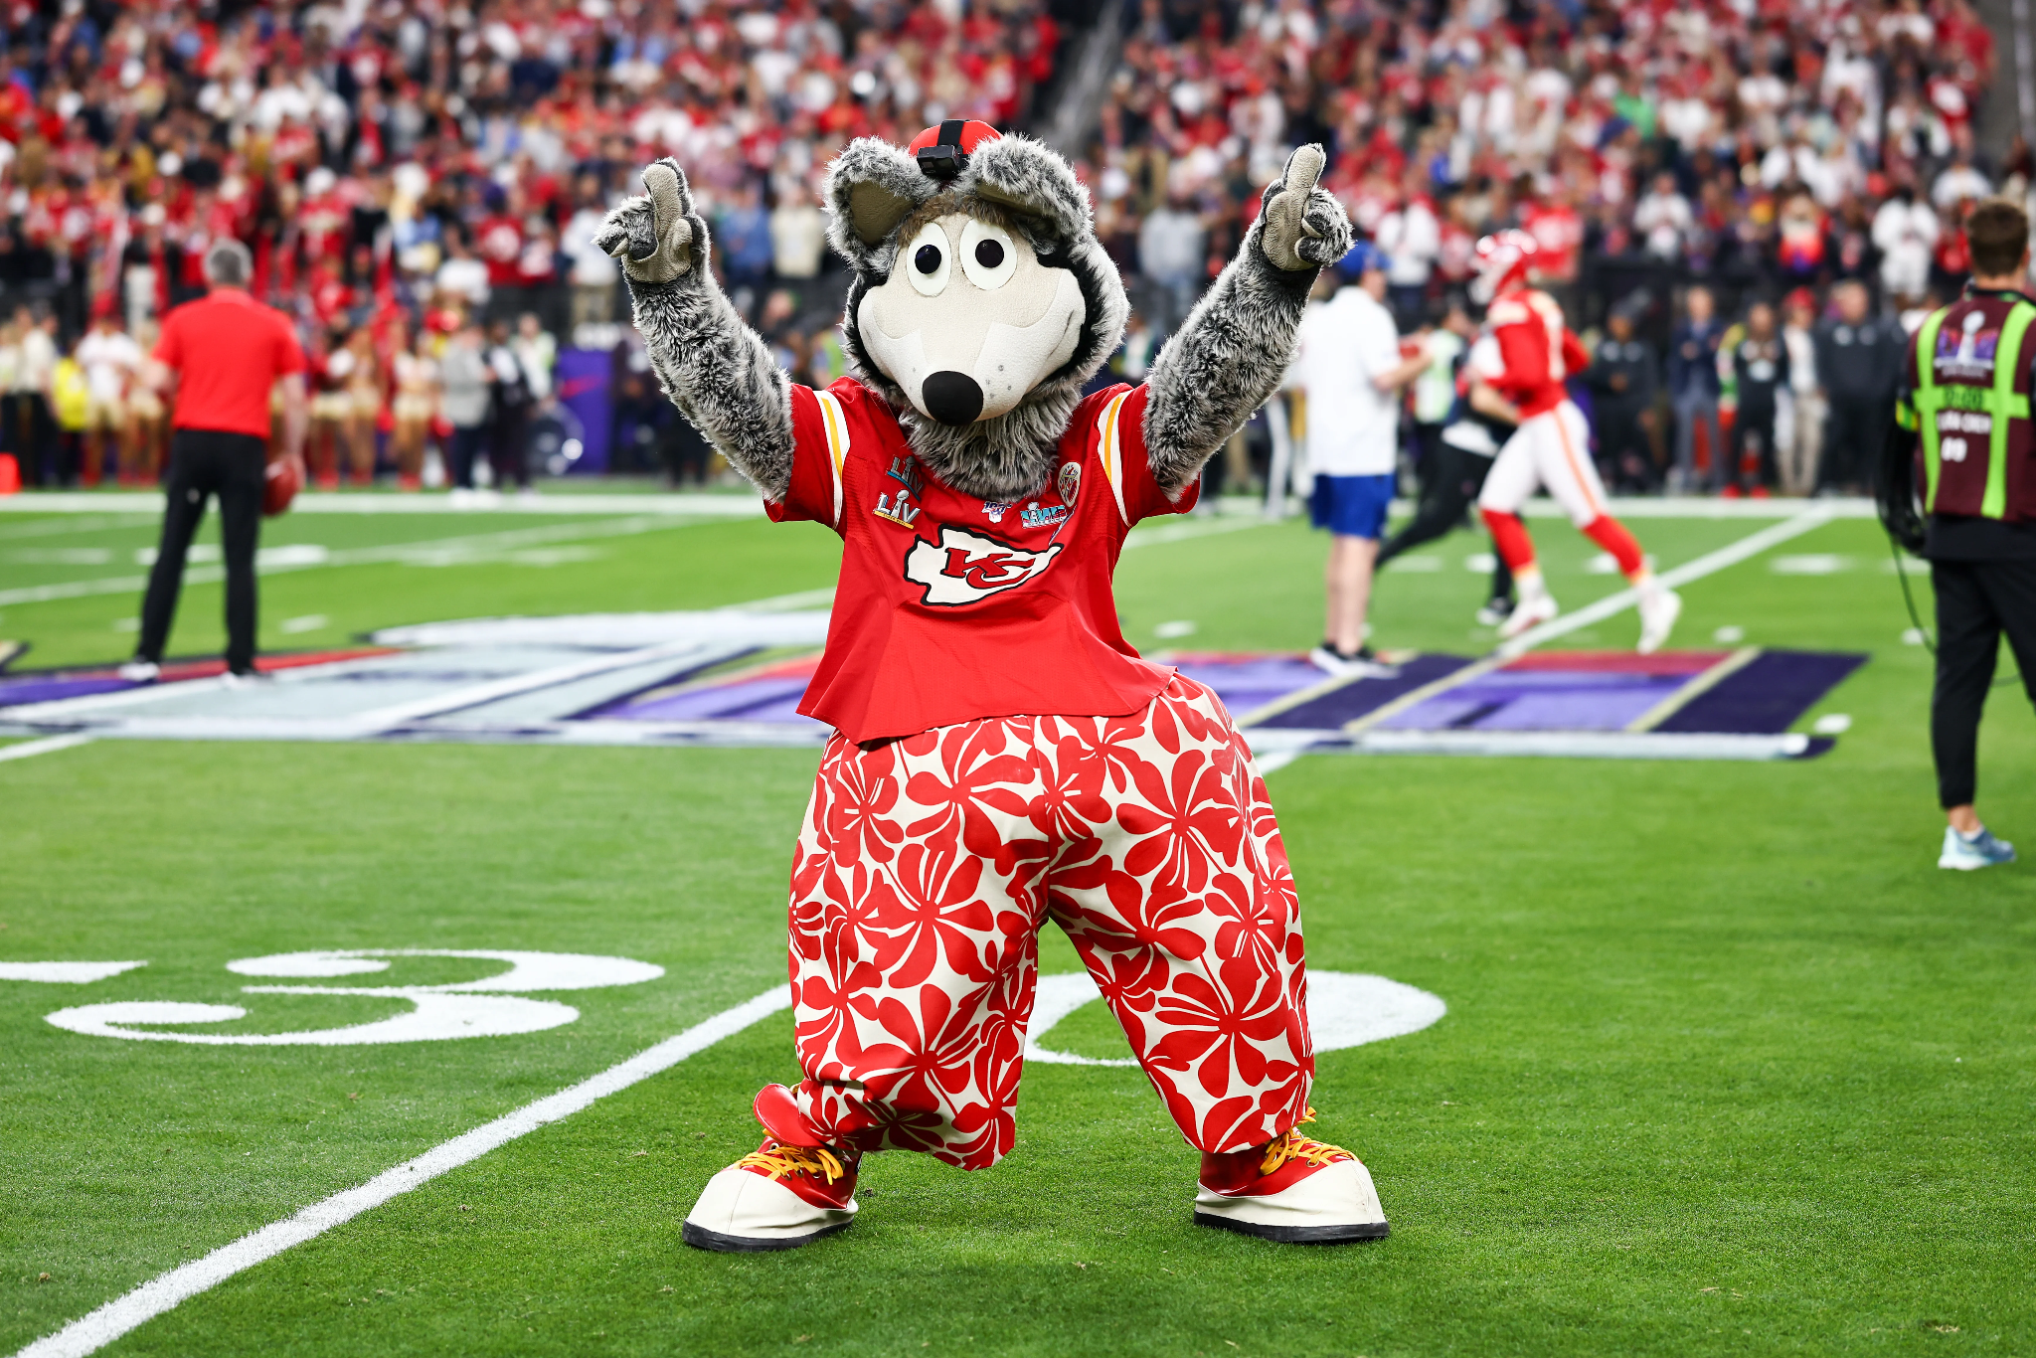
Notes:
KC Wolf - Kansas City Chiefs

Slide 22
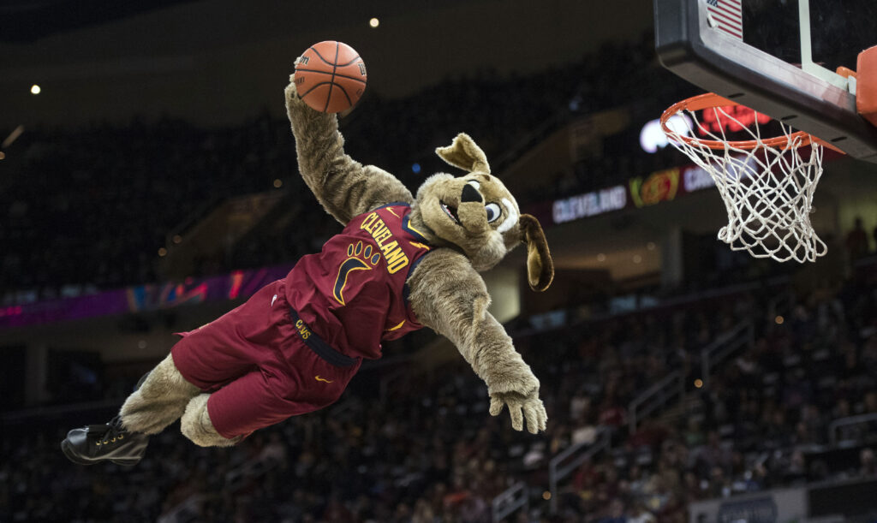
Notes:
Moondog

Slide 23
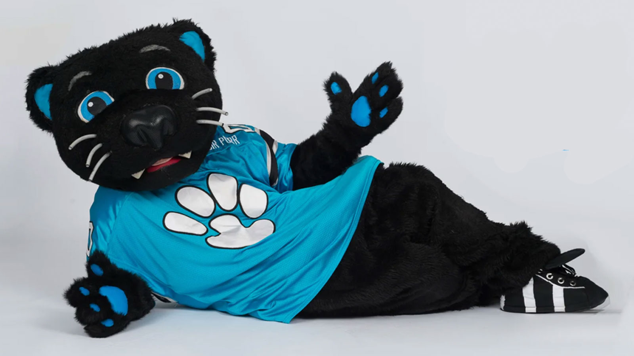
Notes:
Sir Purr - Carolina Panthers

Slide 24
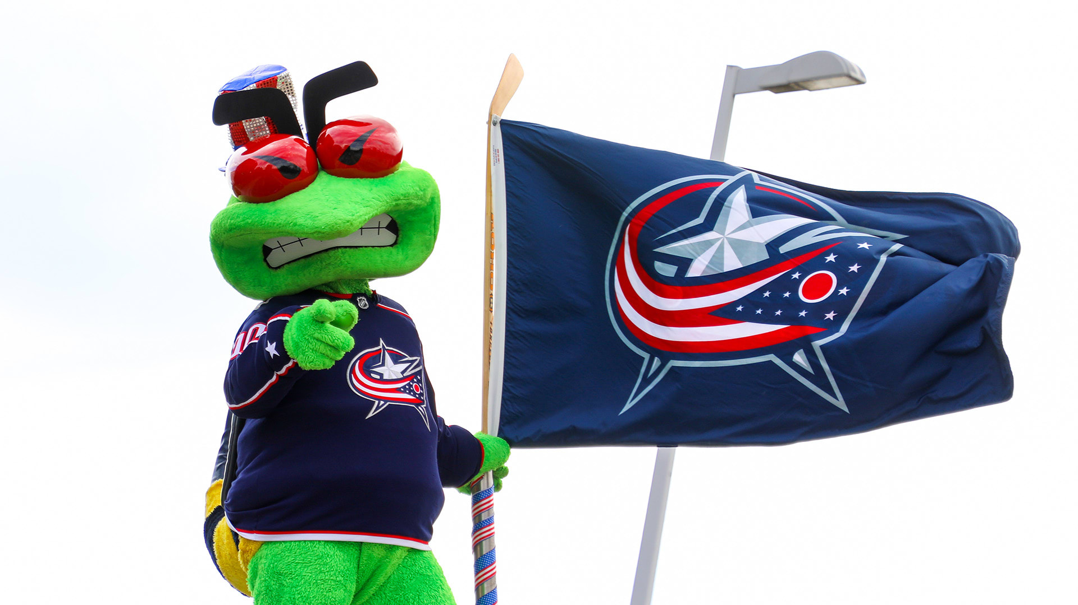
Notes:
Stinger - Columbus Blue Jackets

Slide 25
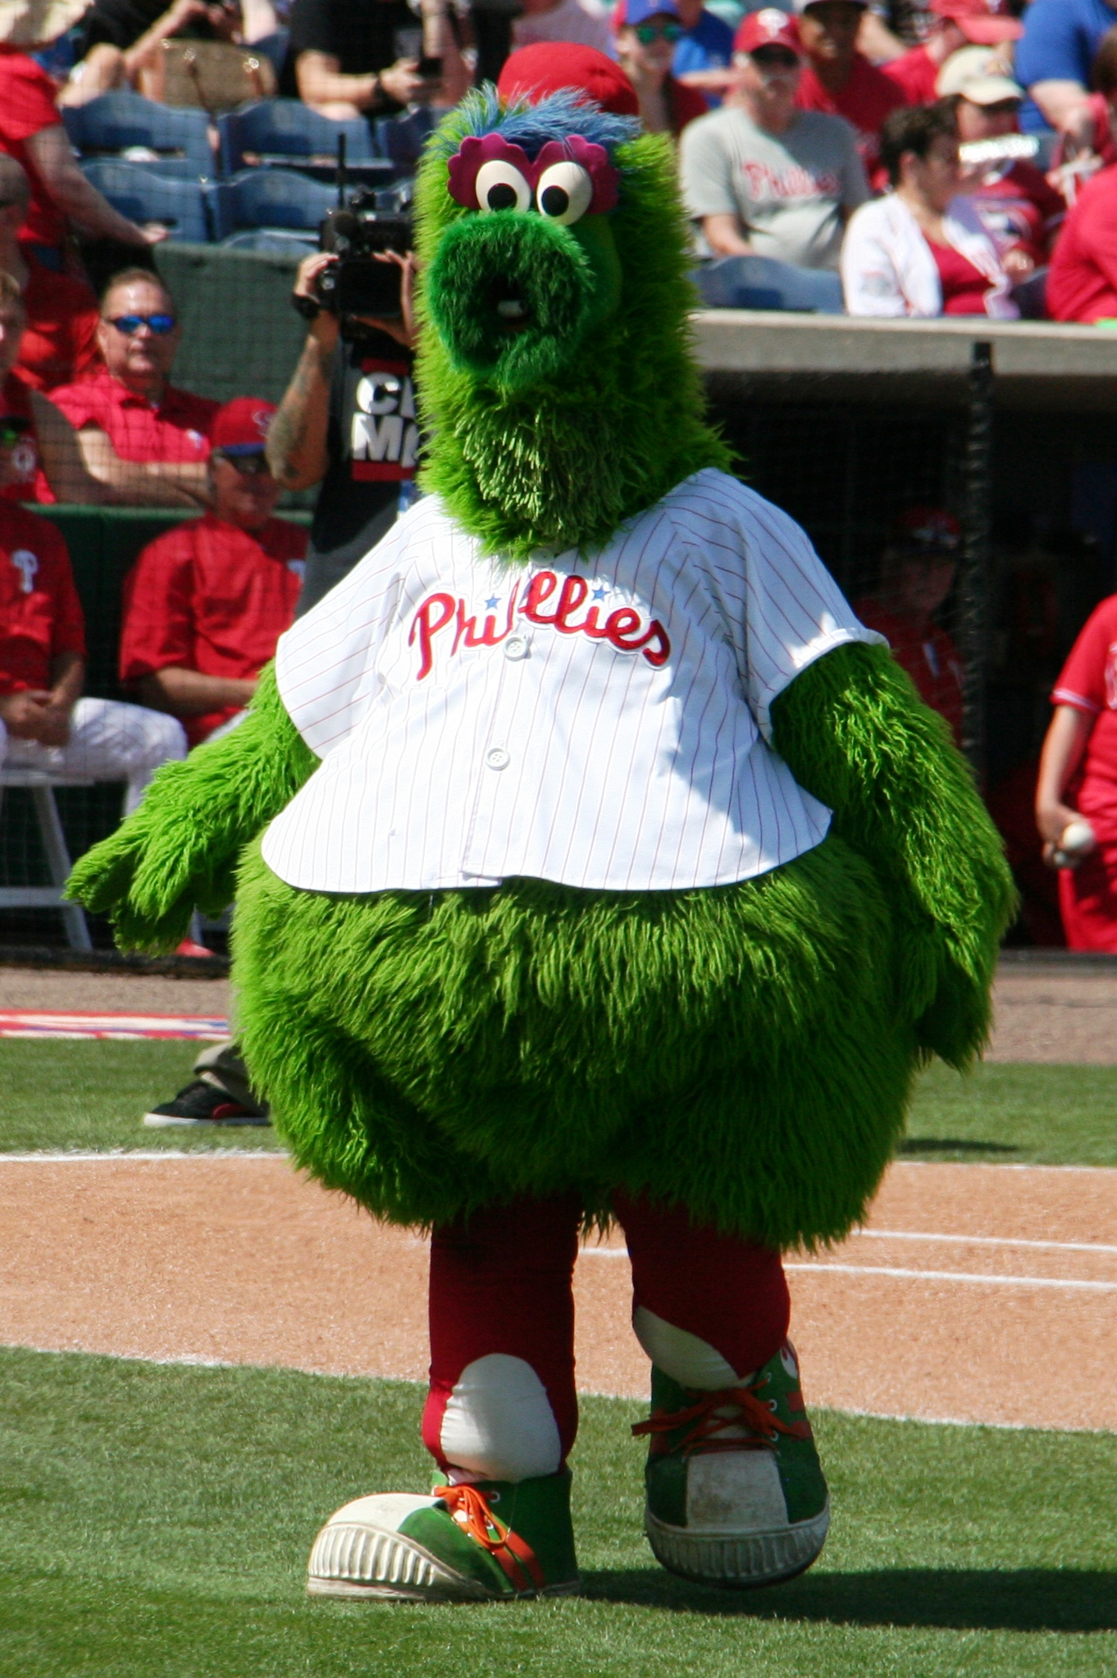
Notes:
Phillie Phanatic

Slide 26
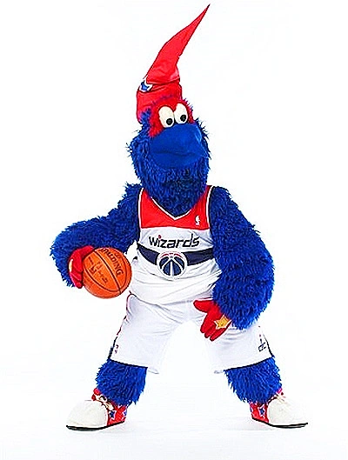
Notes:
G-Wiz

Slide 27
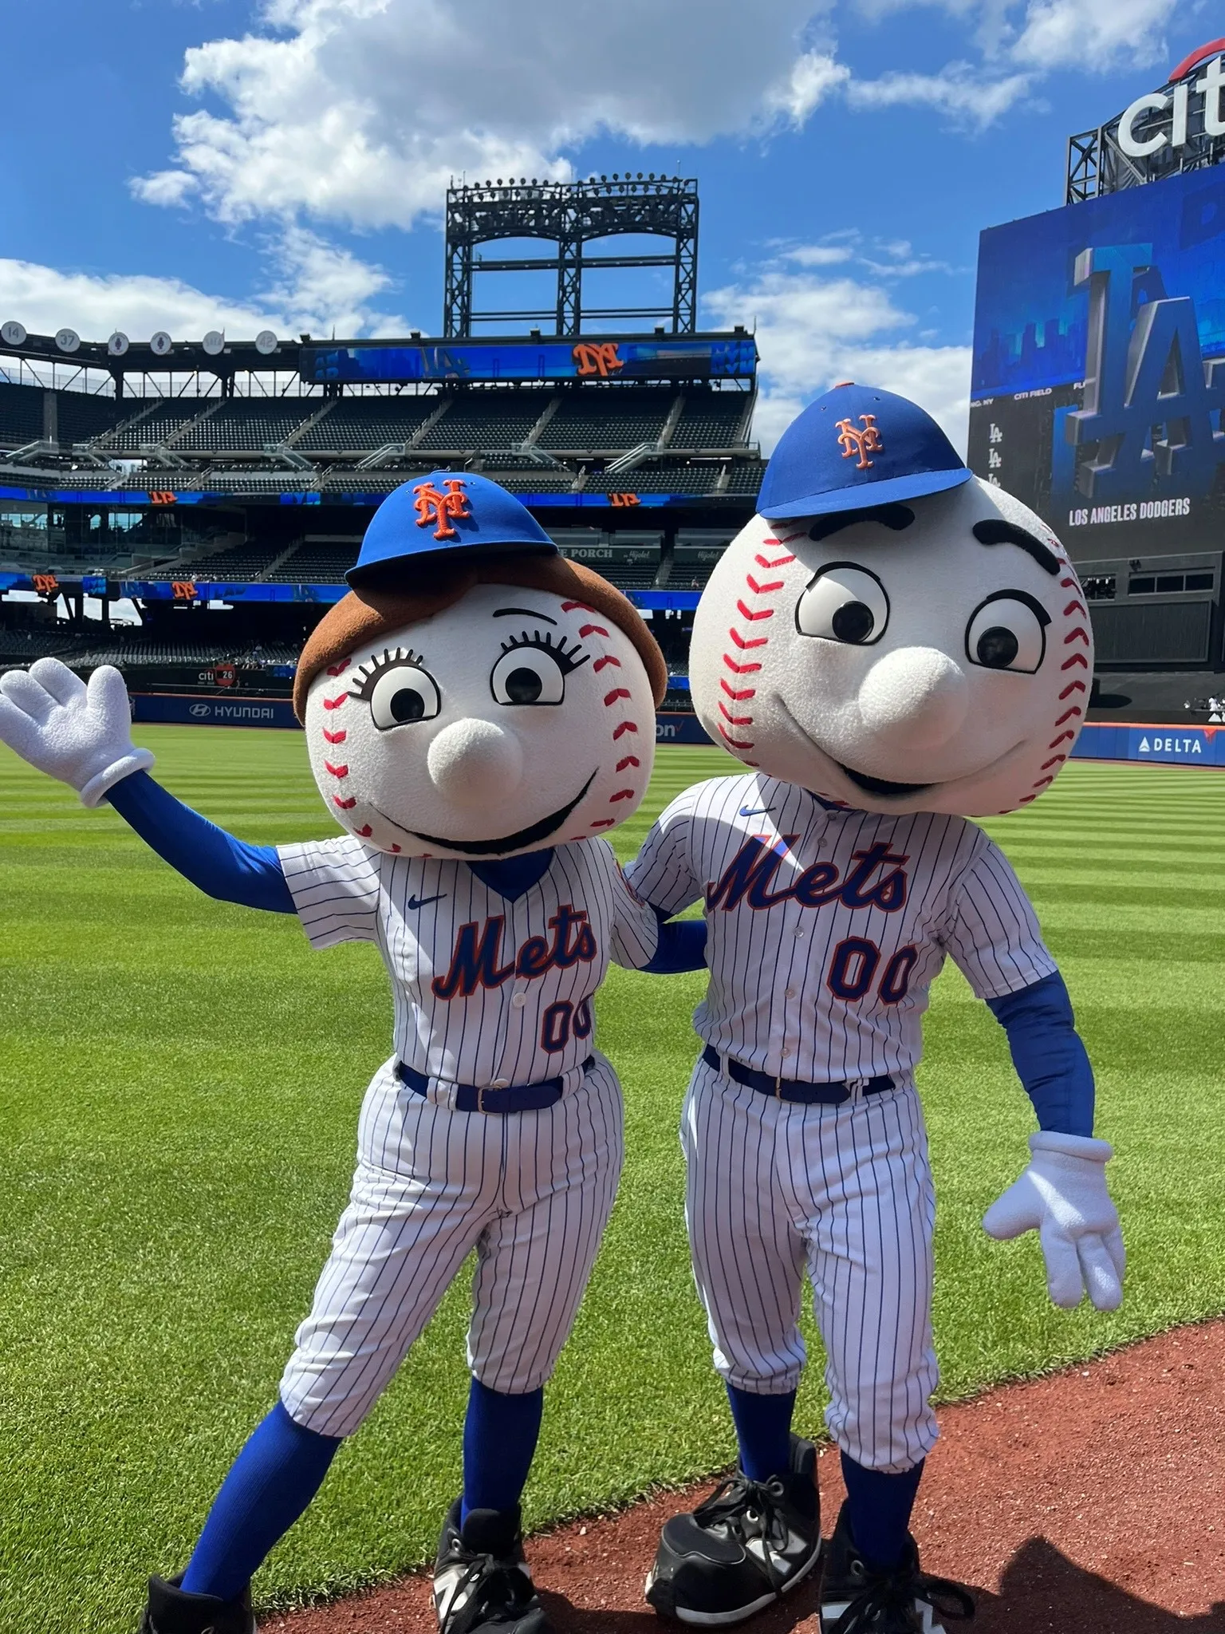
Notes:
Mr and Mrs Met

Slide 28
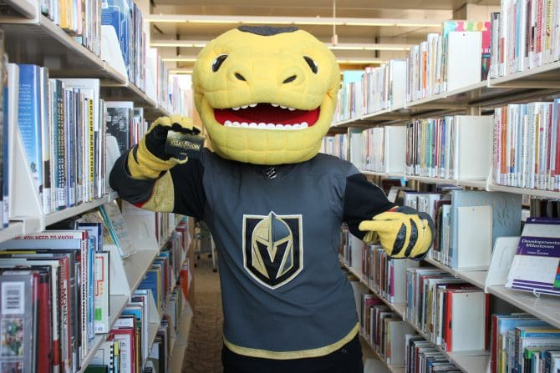
Notes:
Chance

Slide 29
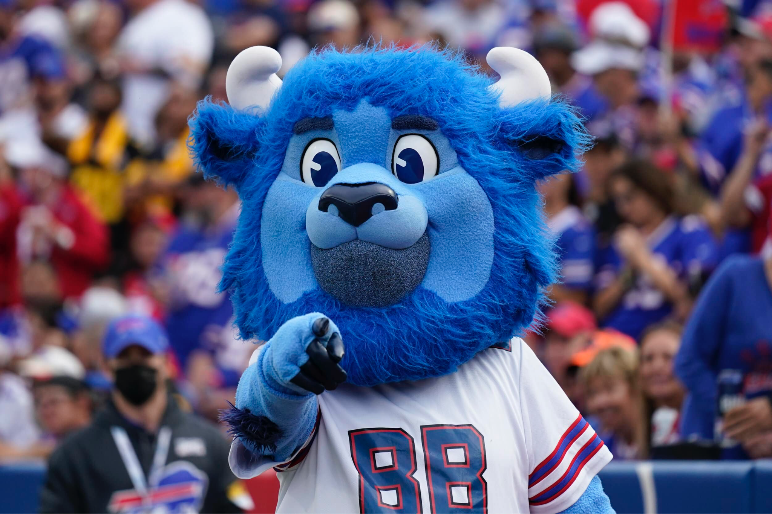
Notes:
Billy Bufalo - Bufalo Bills

Slide 30
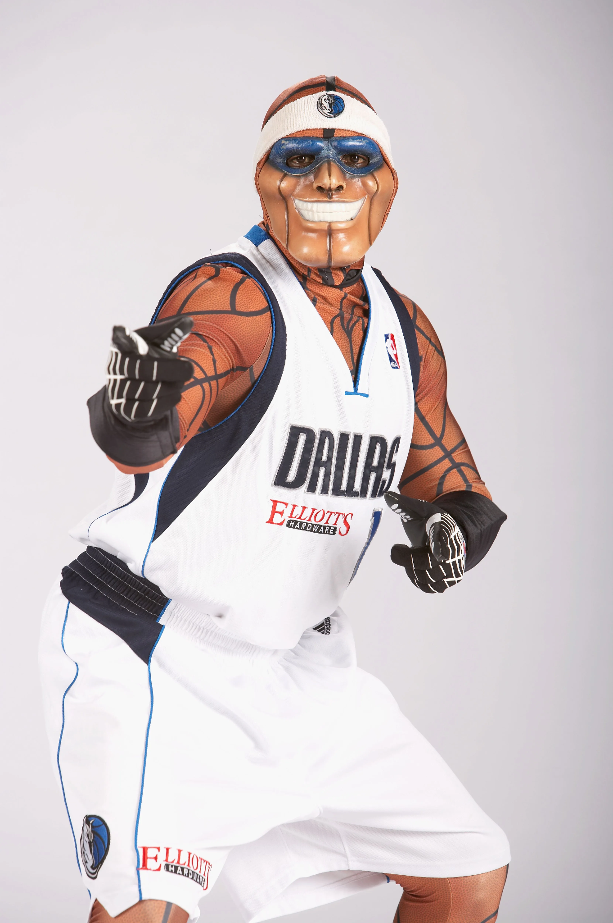
Notes:
Mavs Man

Slide 31
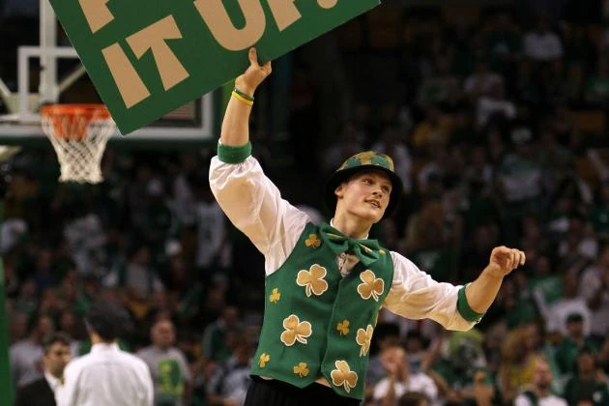
Notes:
Lucky the leprechaun

Slide 32

Notes:
Stormy the Ice Hog - Carolina Hurricans

Slide 33
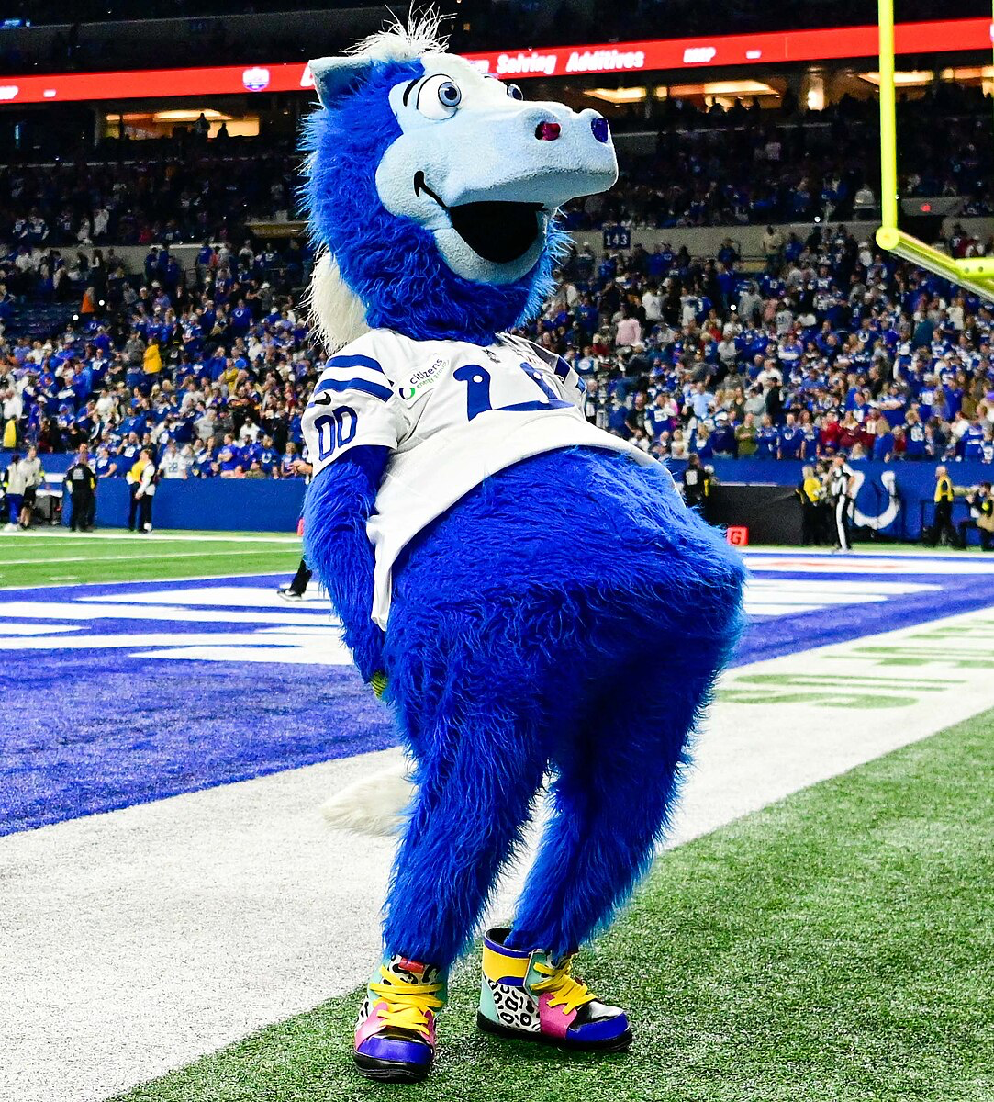
Notes:
Blue - Indianapolis Colts

Slide 34
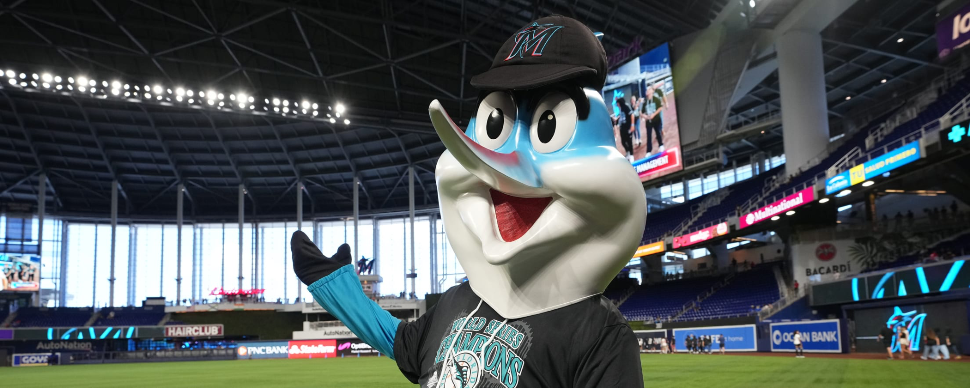
Notes:
Billy the Marlin

Slide 35
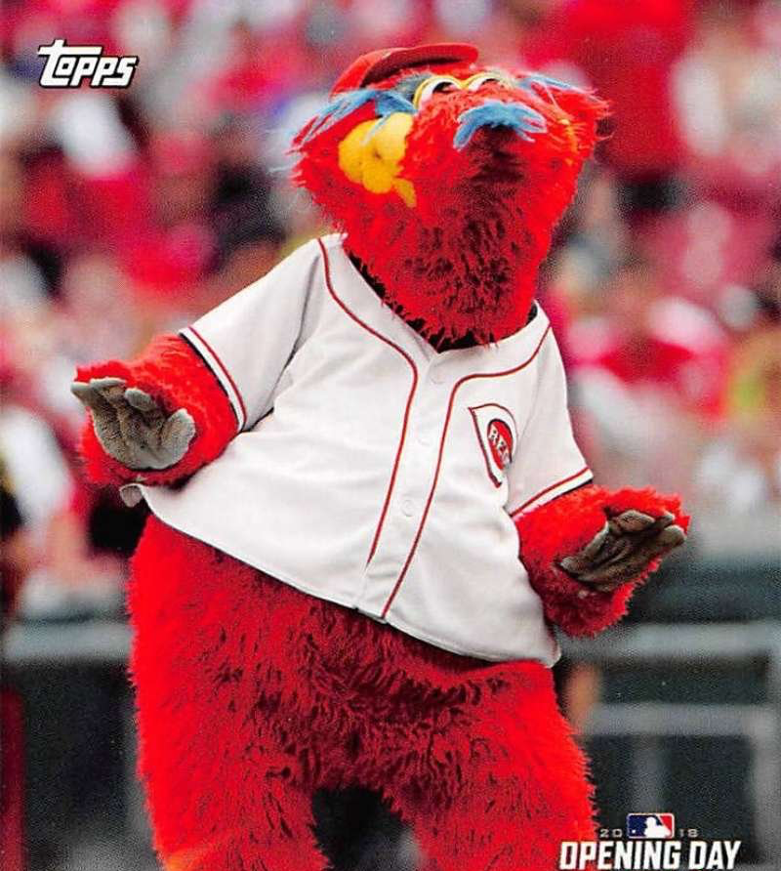
Notes:
Gapper

Slide 36
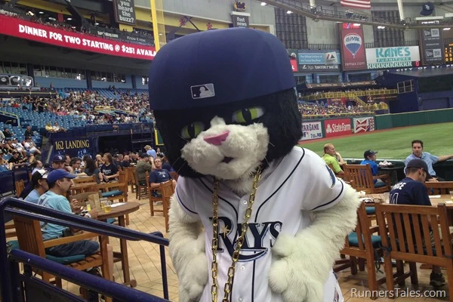
Notes:
DJ Kitty

Slide 37
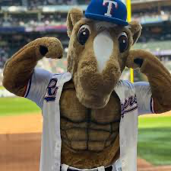
Notes:
Rangers Captain

Slide 38
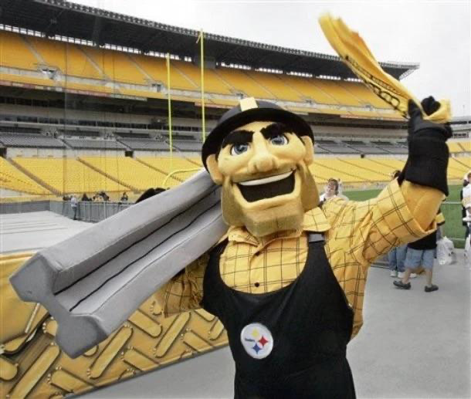
Notes:
Steely McBeam - Pittsburg Steelers

Slide 39
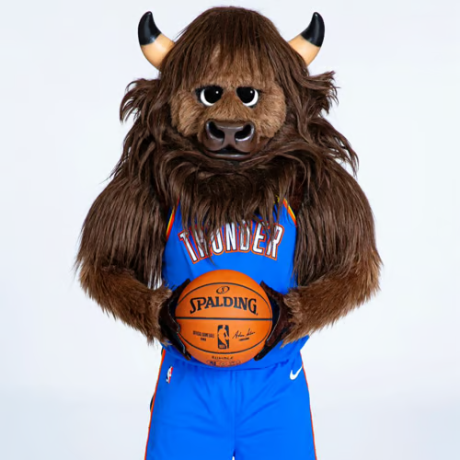
Notes:
Rumble the Bison

Slide 40
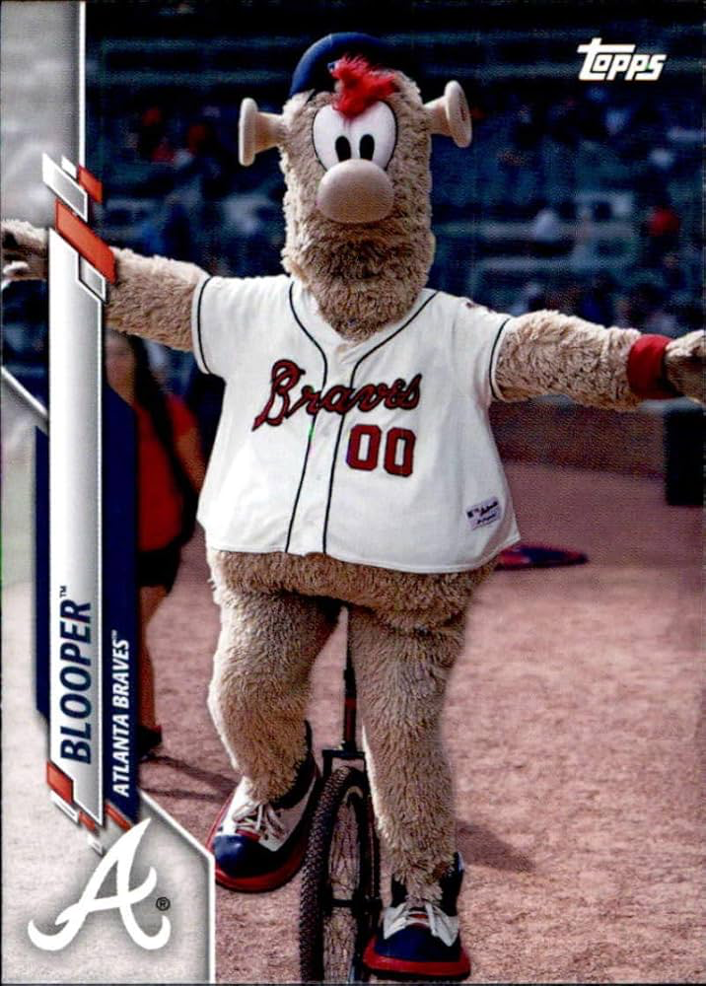
Notes:
Blooper

Slide 41
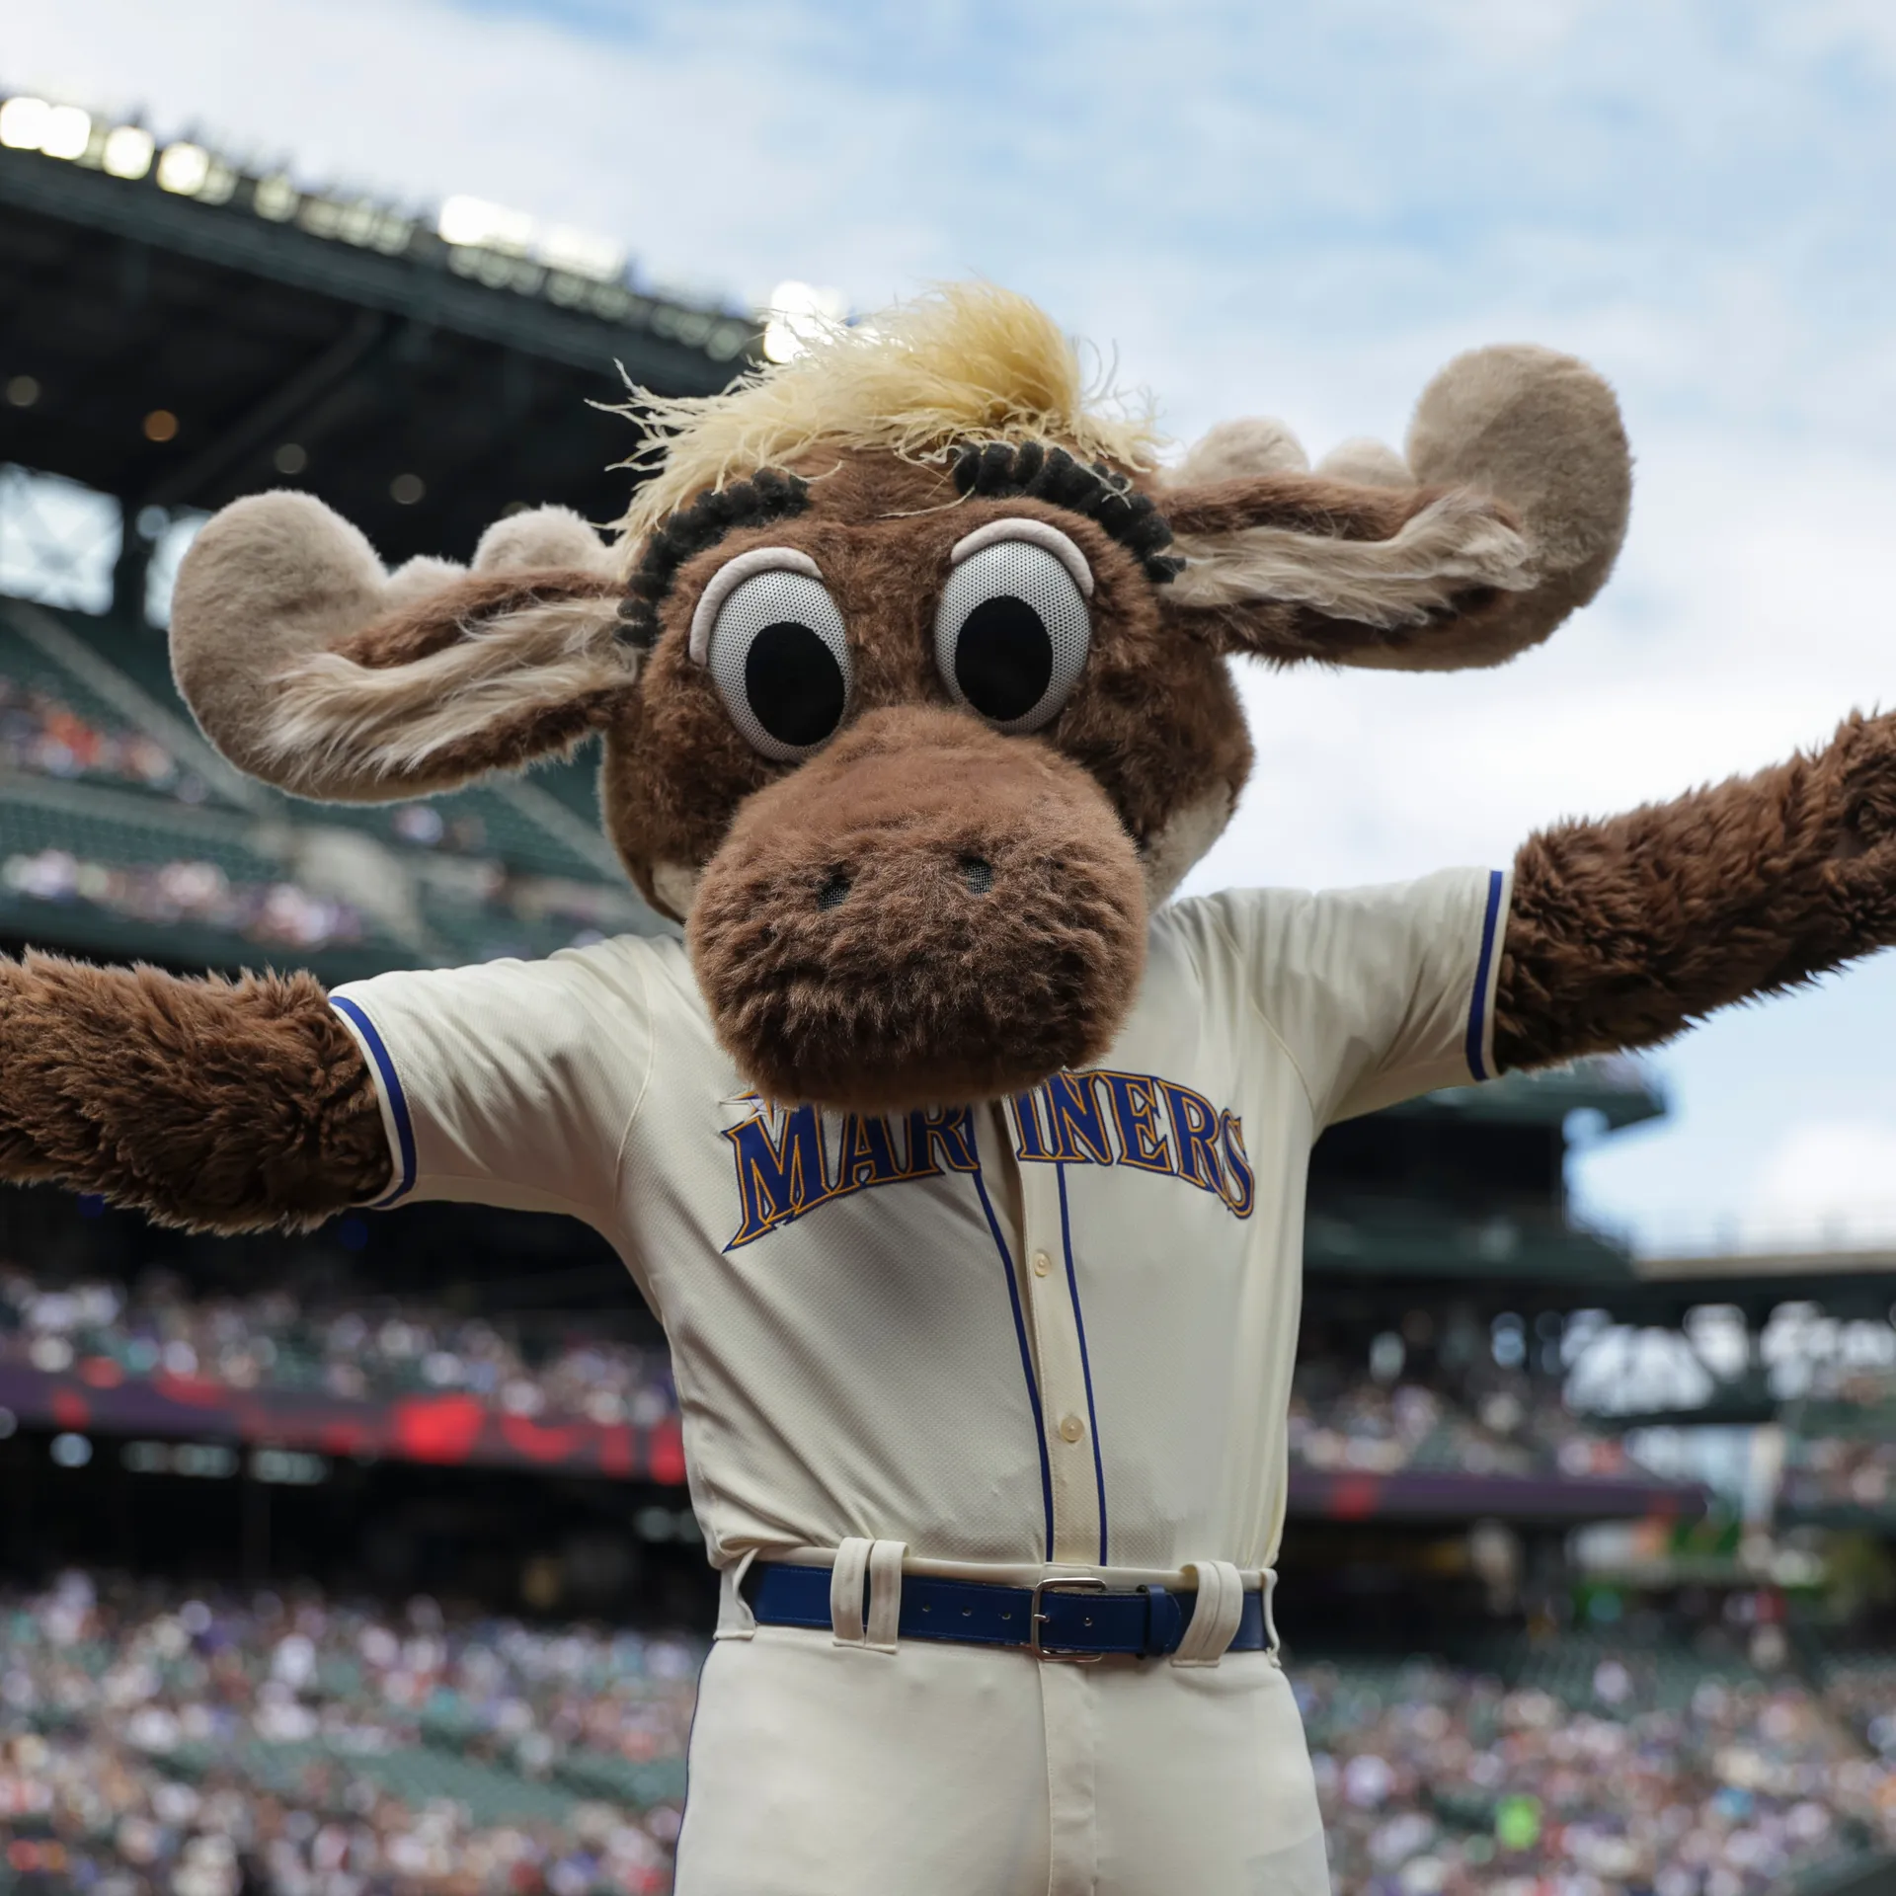
Notes:
Mariner Moose

Slide 42
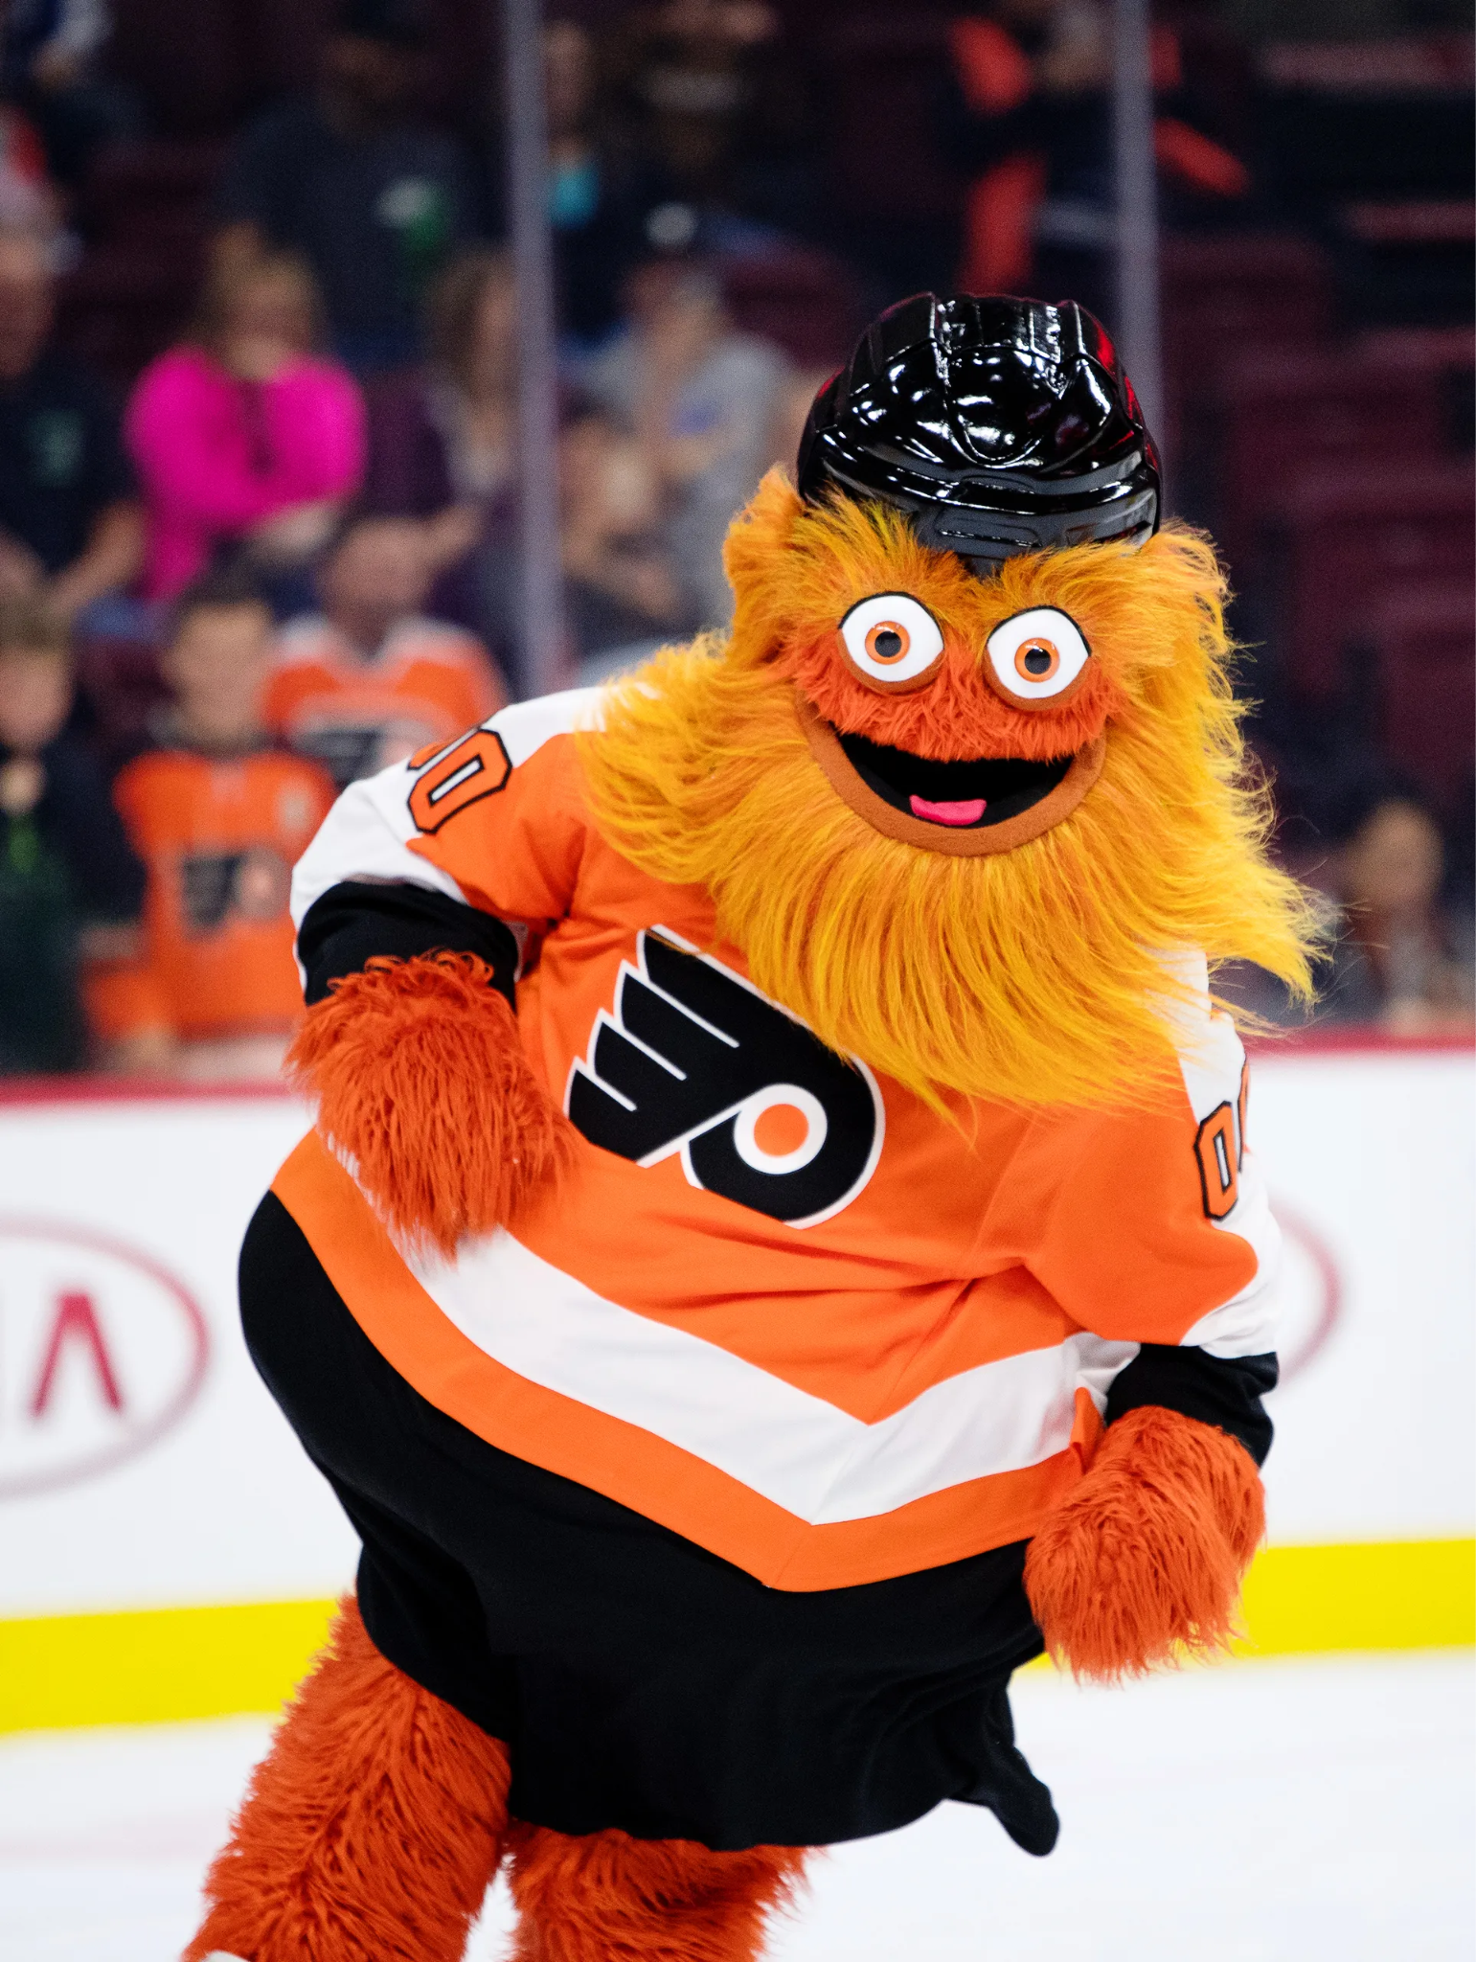
Notes:
Gritty

Slide 43
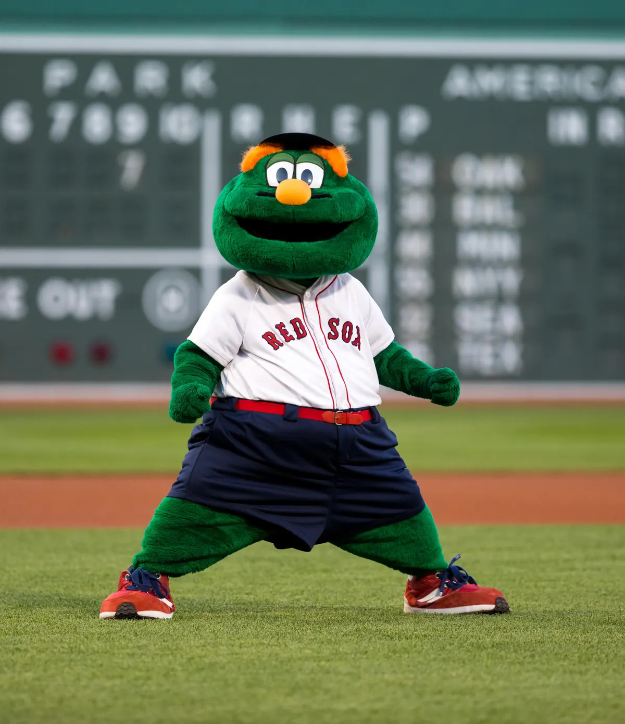
Notes:
Wally the Green Monster

Slide 44
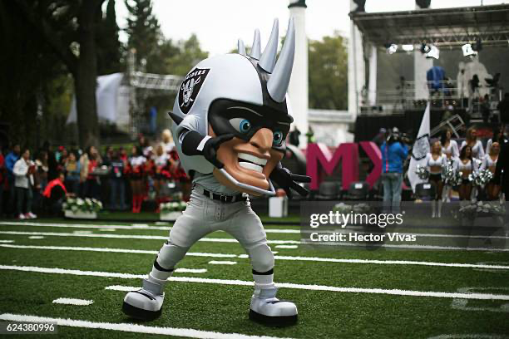
Notes:
Raider Rusher

Slide 45
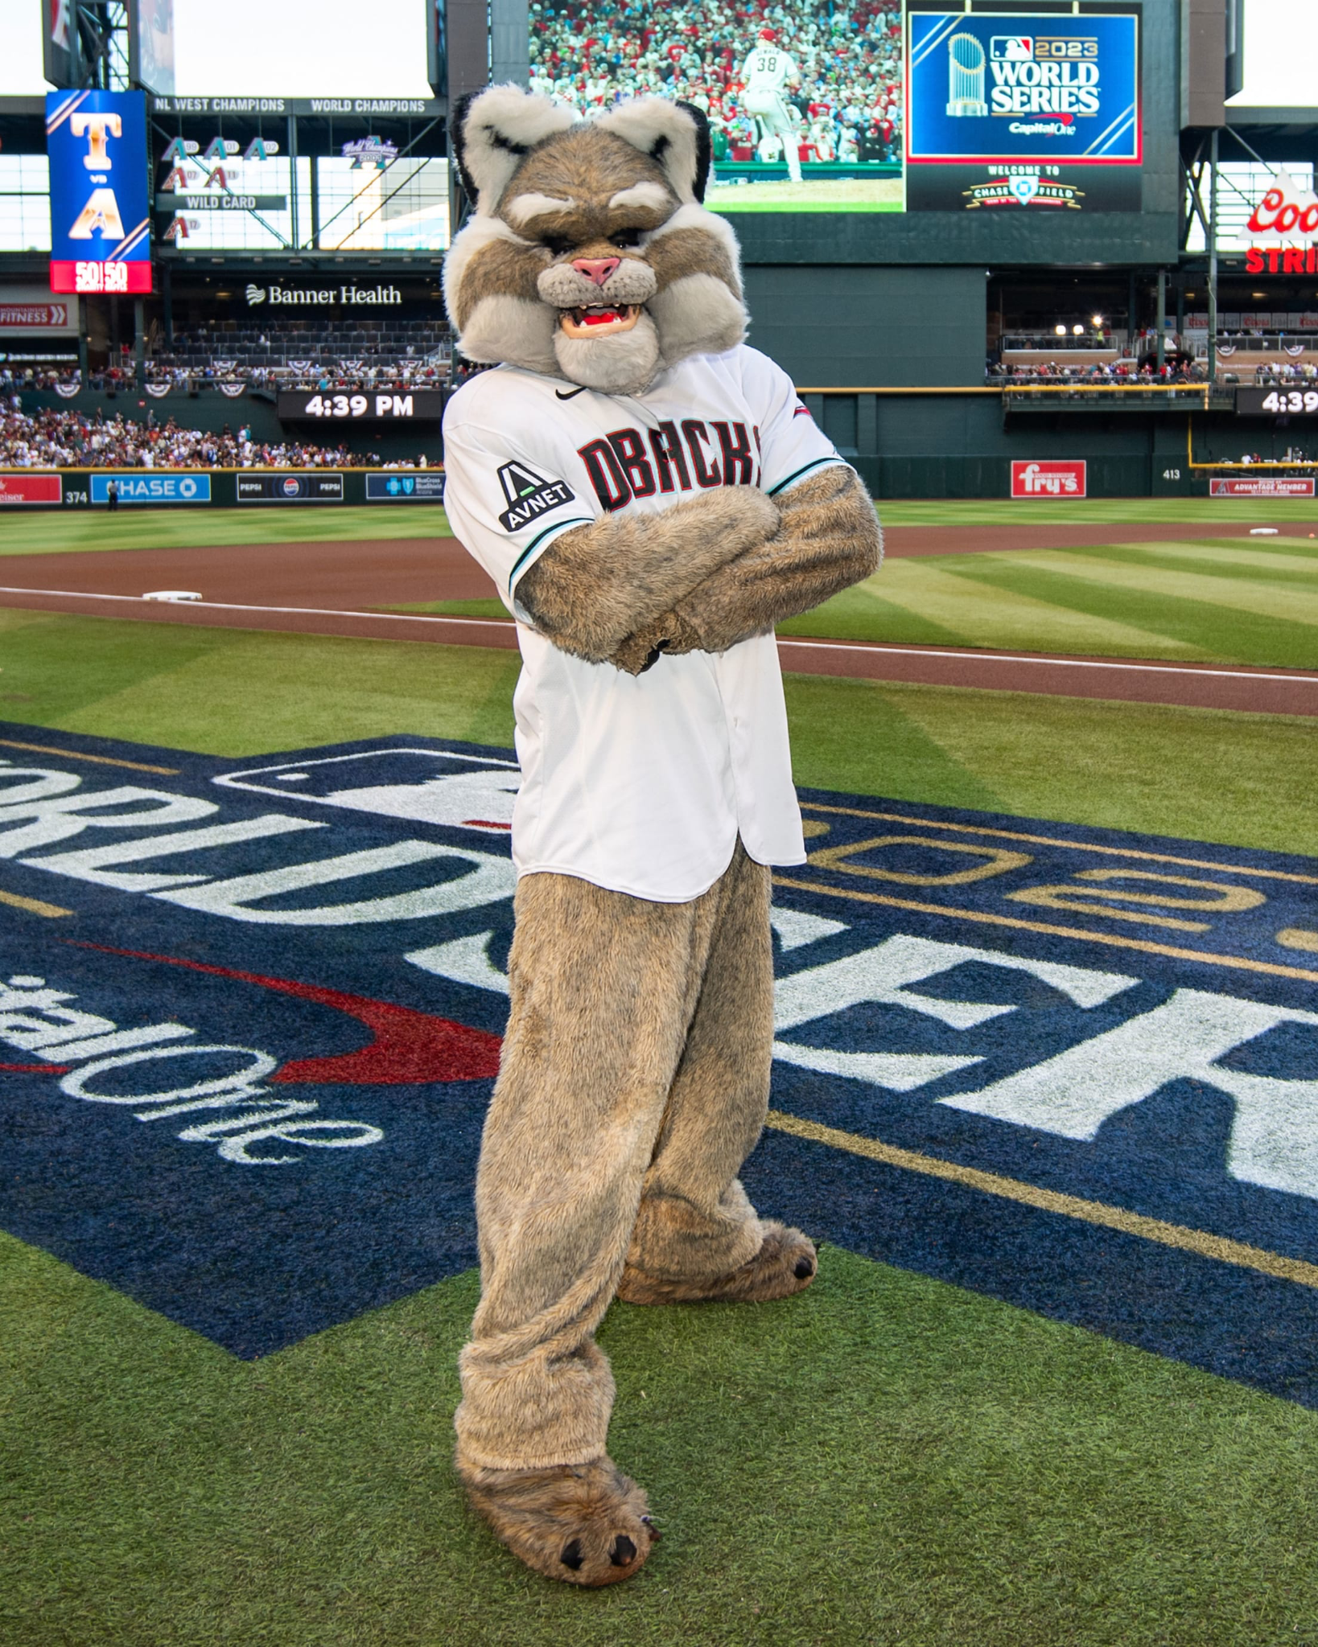
Notes:
Baxter Bobcat

Slide 46
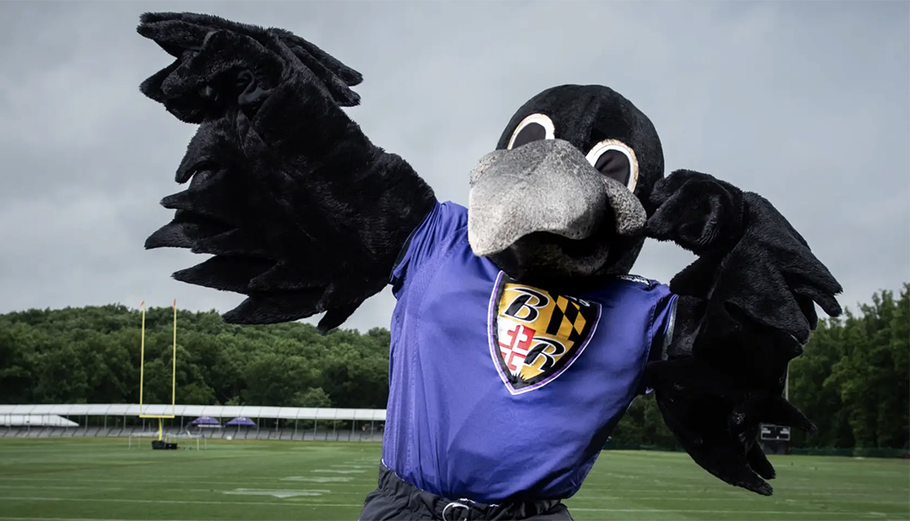
Notes:
Poe

Slide 47
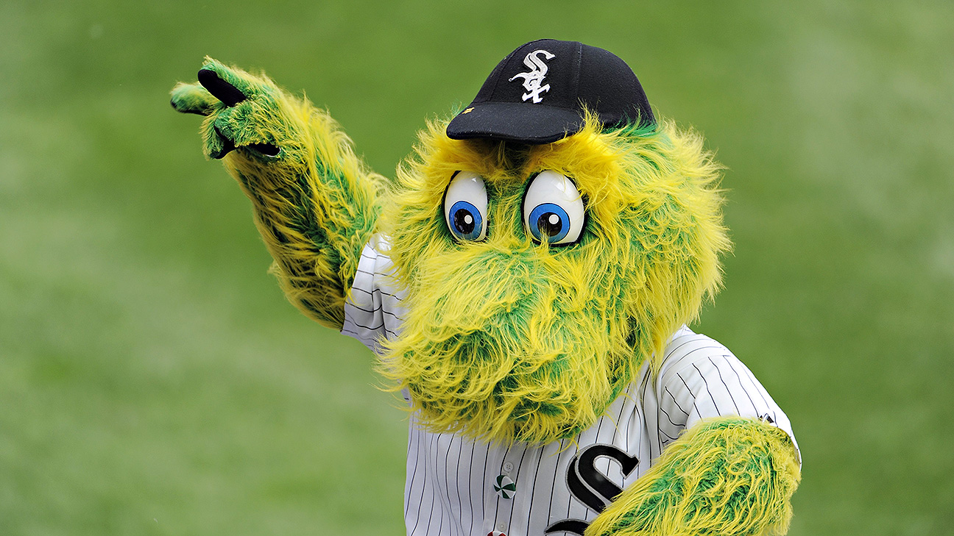
Notes:
South paw

Slide 48
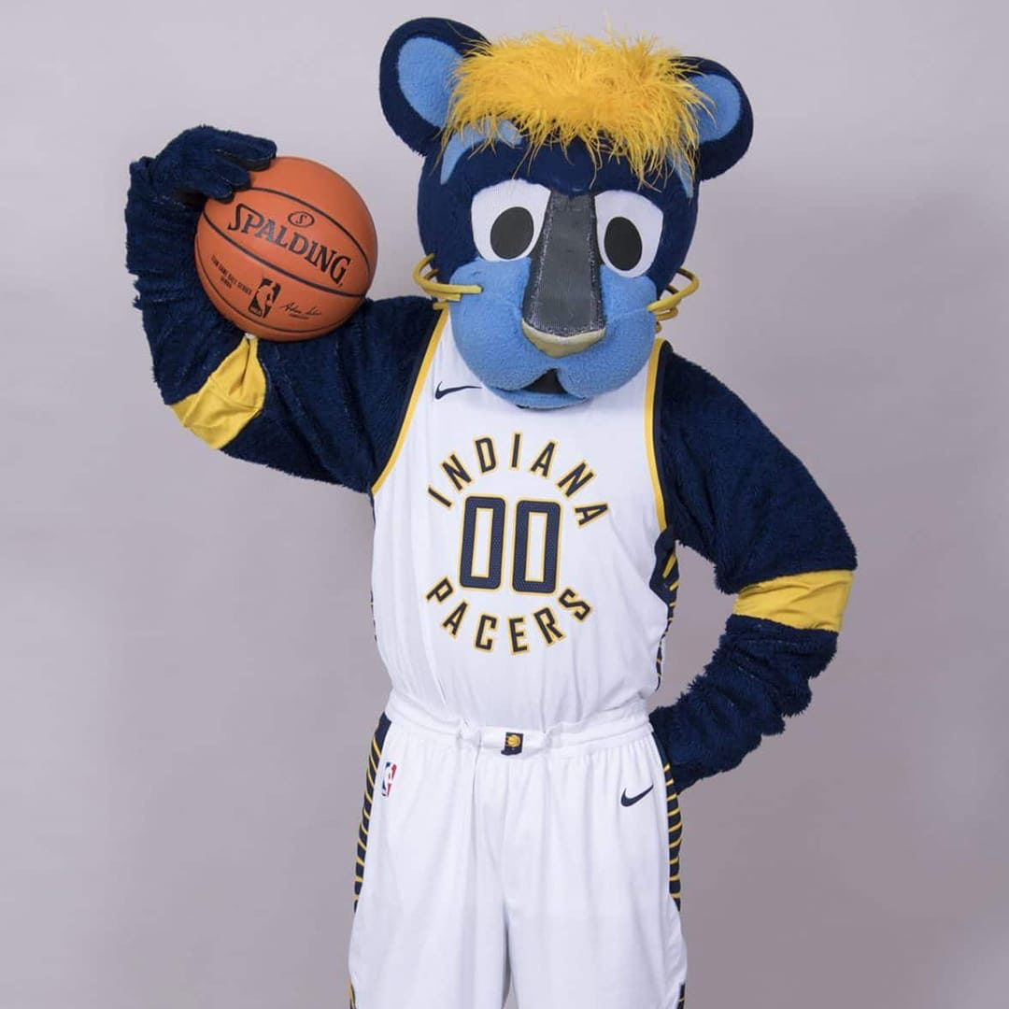
Notes:
Boomer

Slide 49
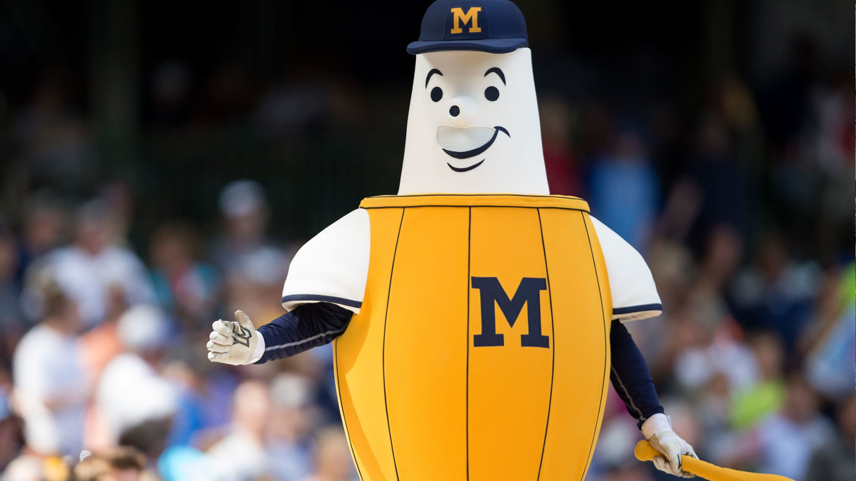
Notes:
Barrelman

Slide 50
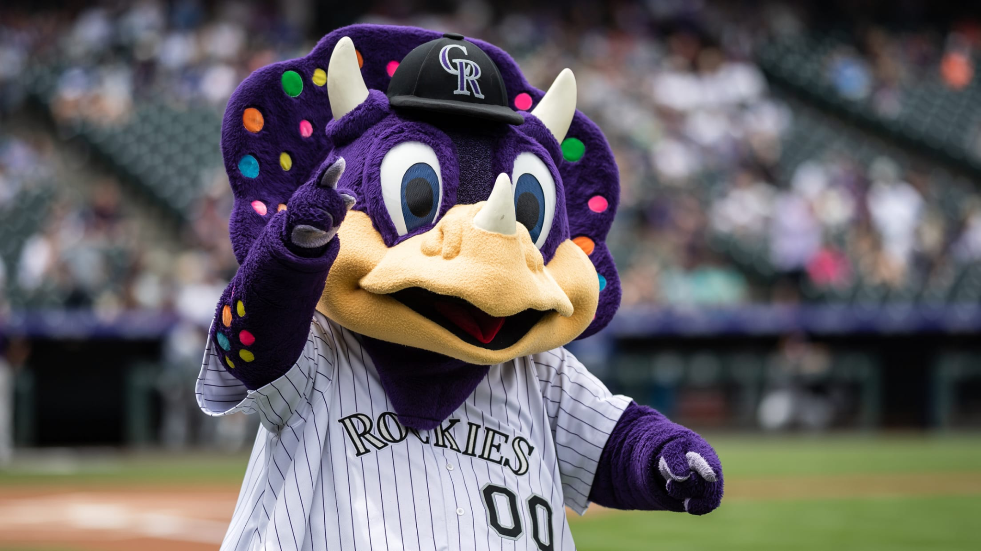
Notes:
Dinger

